Slide 1
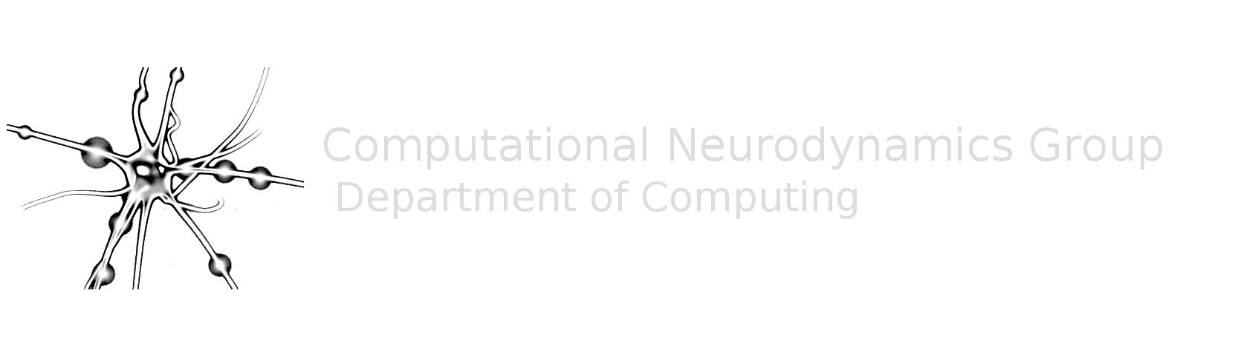


Effects of lesions on dynamics in cortical networks
C³NL
Computational, Cognitive & Clinical Neuroimaging Laboratory
František Váša
fv247@cam.ac.uk
@frantisekvasa
Cambridge Connectome Consortium
24th May 2016

Slide 2
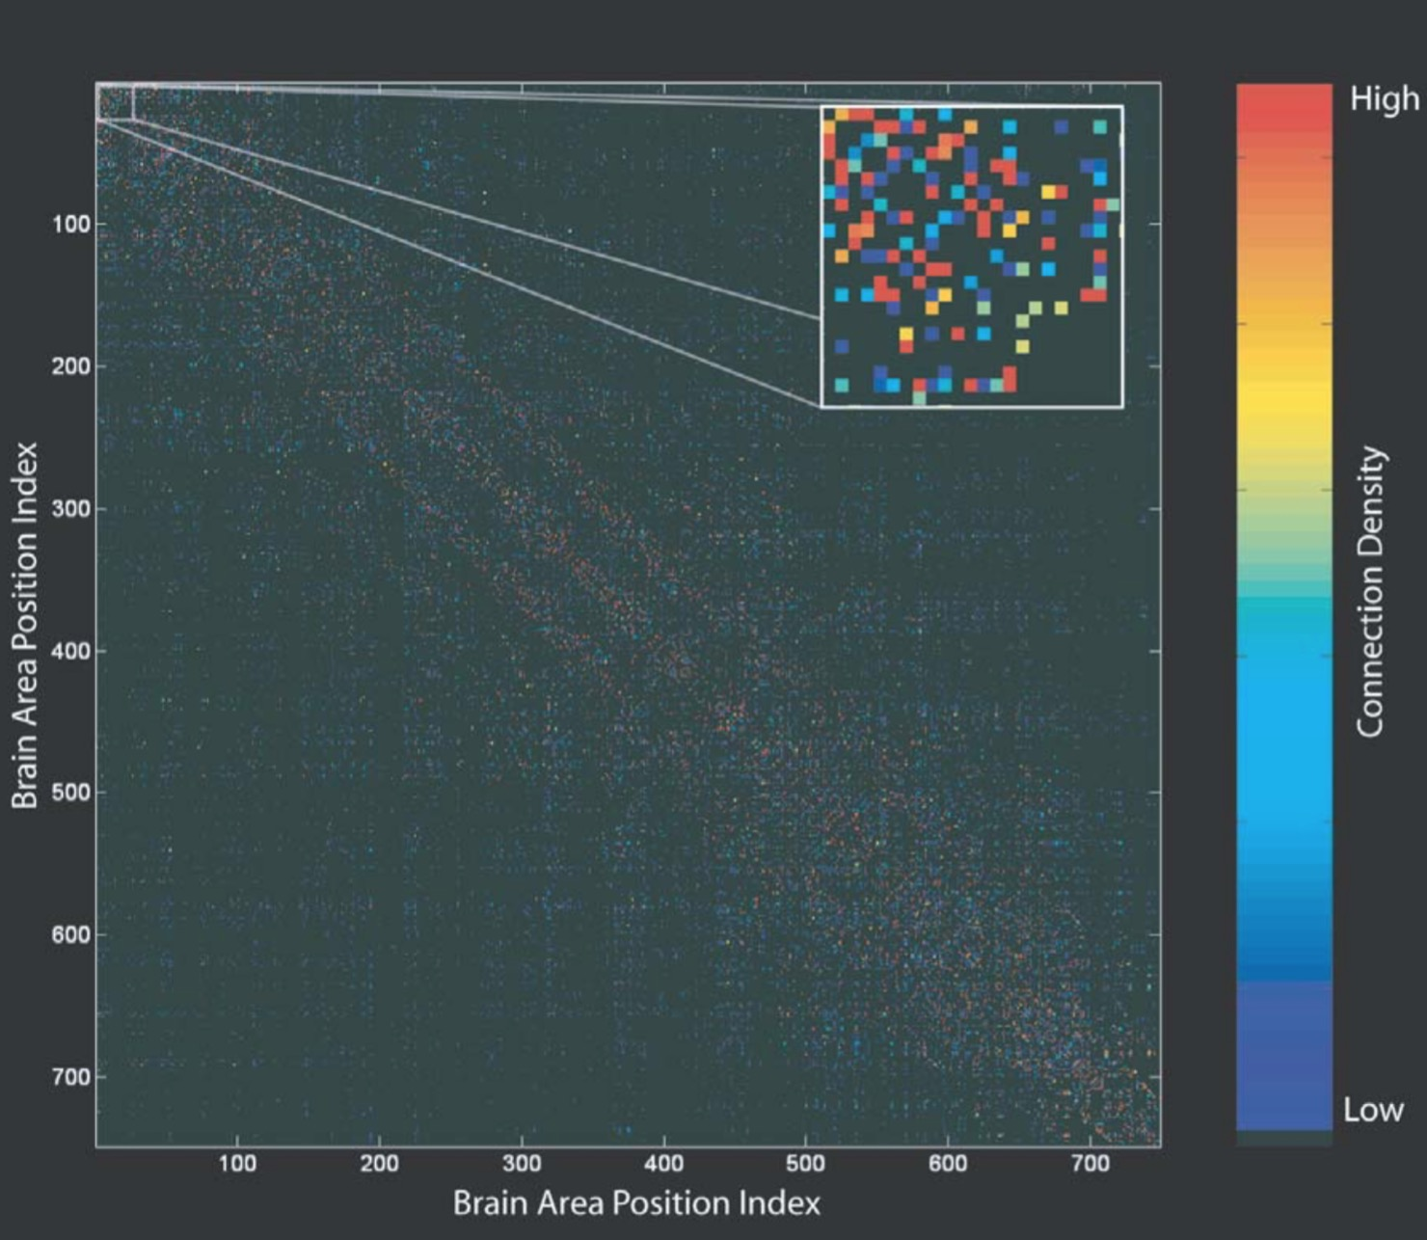
Framework - The “Connectome”
Sporns et al. PLoS Comp. Biol. 2005 + Hagmann PhD Thesis 2005
“An obvious […] use of the human connectome would be providing structural information that can be implemented as part of large-scale computational models”
“Most importantly, the connectome will provide an important tool for mechanistic modeling and interpretation of human functional brain data.”

Slide 3
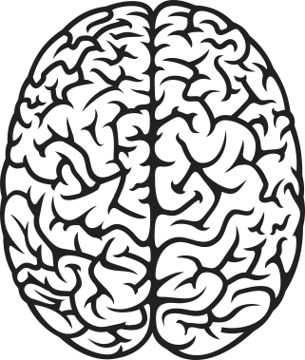
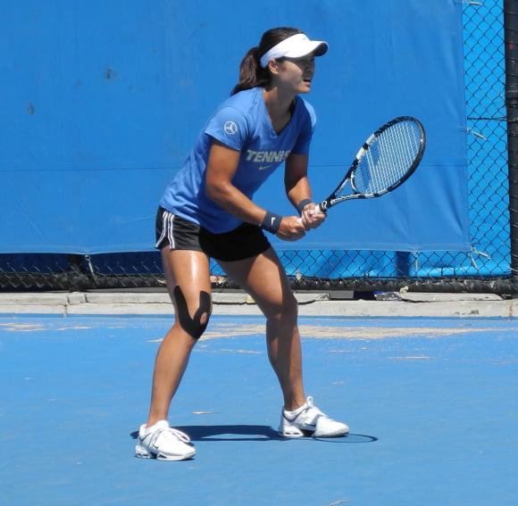
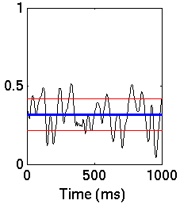
Neural dynamics
Coherence matters, as does its variability
Fries Trends. Cog. Sci. 2005 communication through coherence
Neural dynamics are not stable, but “metastable”
Deco et al. PNAS 2009 “resting brains never rest”
Shanahan Chaos 2011 metastability metric
Formally: stability ≠ multistability ≠ metastability
Coherence

Slide 4
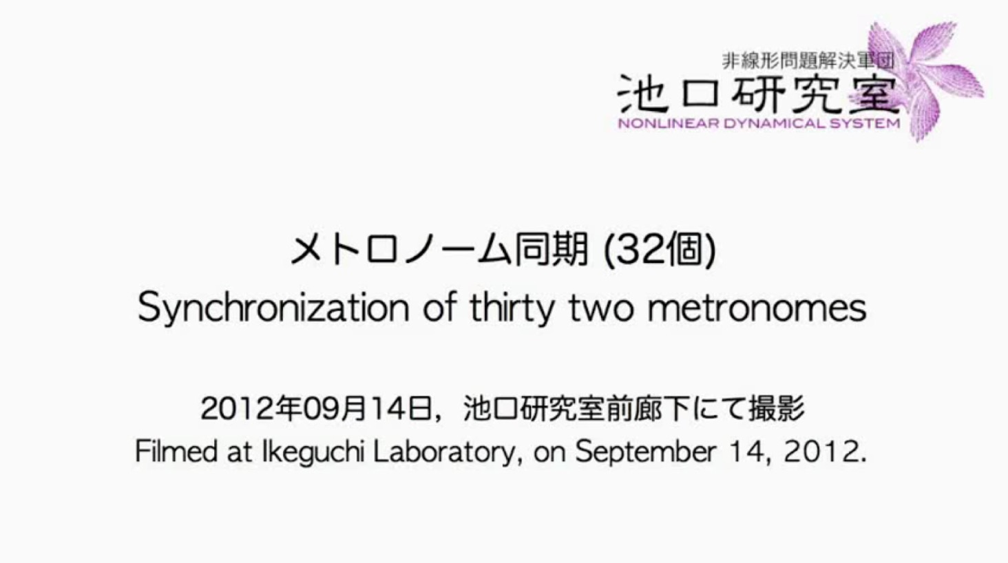
Synchronisation in coupled systems
Video at: https://www.youtube.com/watch?v=JWToUATLGzs

Slide 5
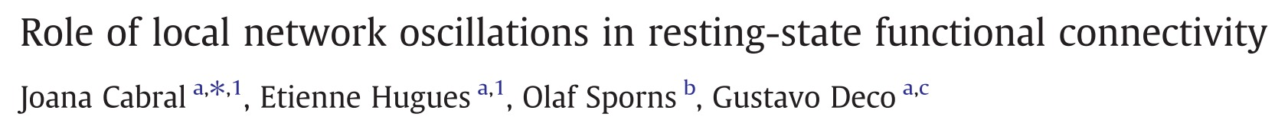
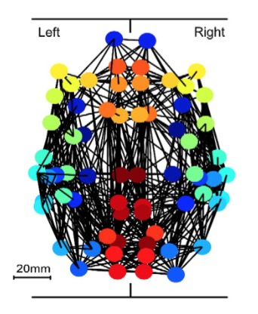
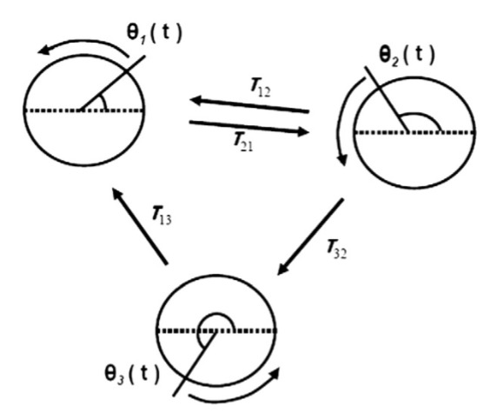
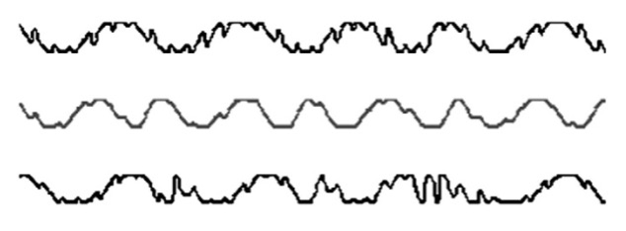
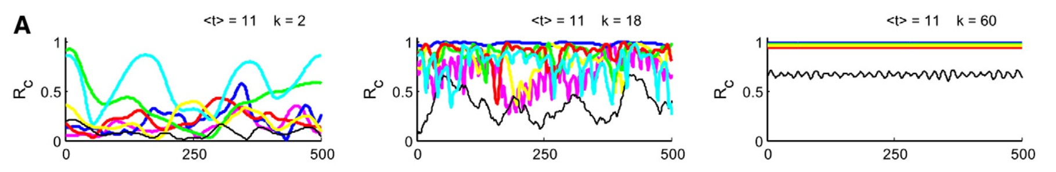
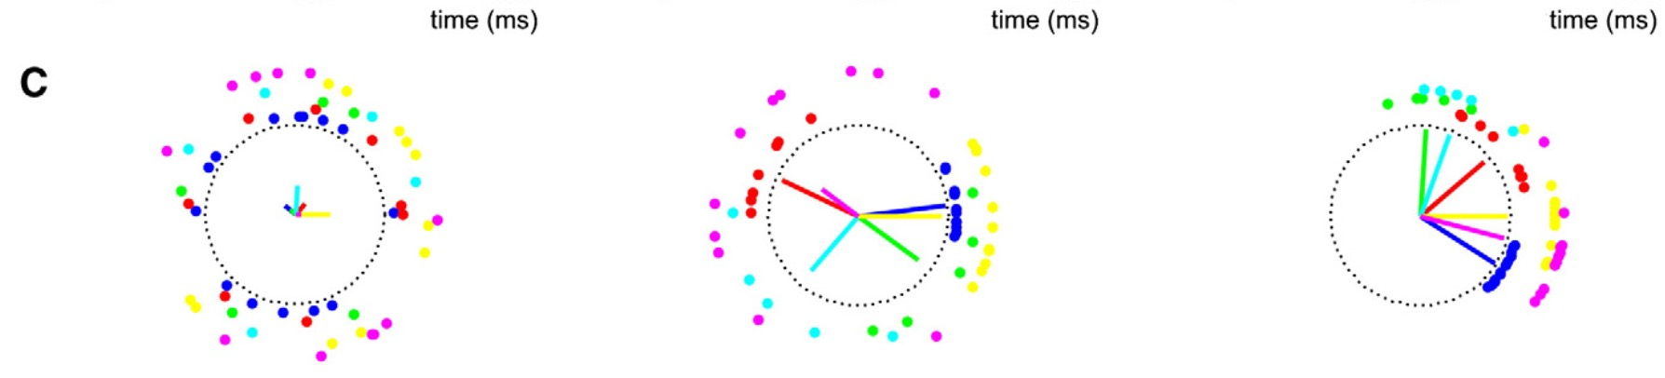
Background: dynamics
Neuroimage 2011
+
=
low coupling
high coupling

Slide 6
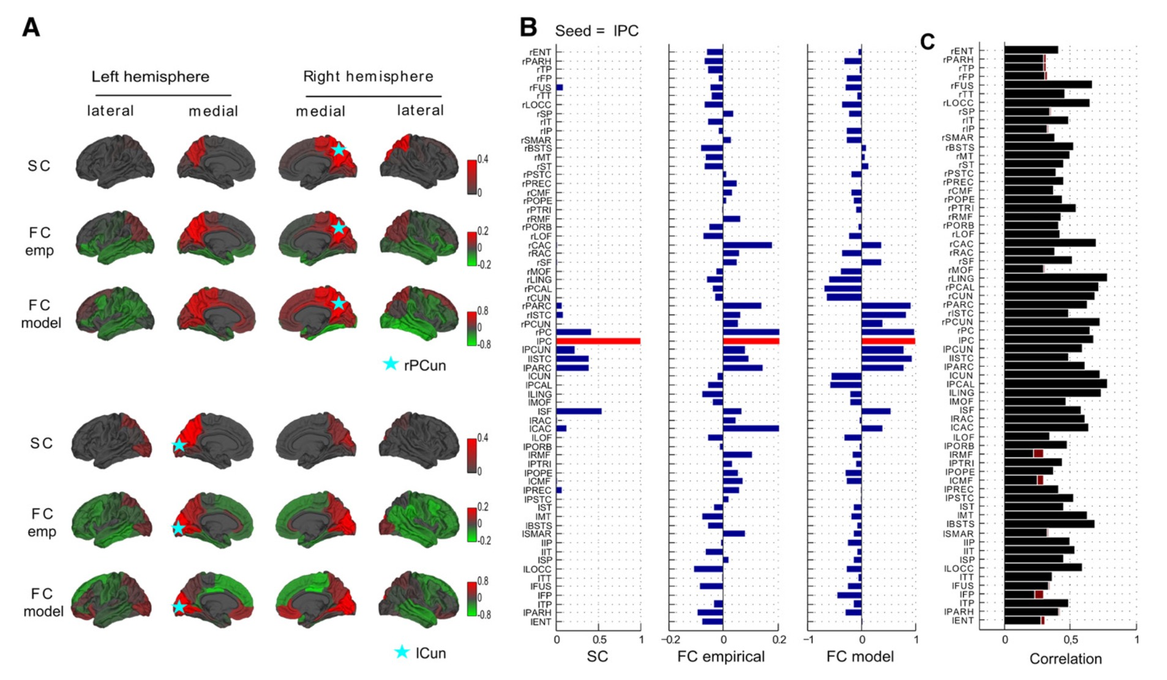
Background: dynamics
Neuroimage 2011

Slide 7
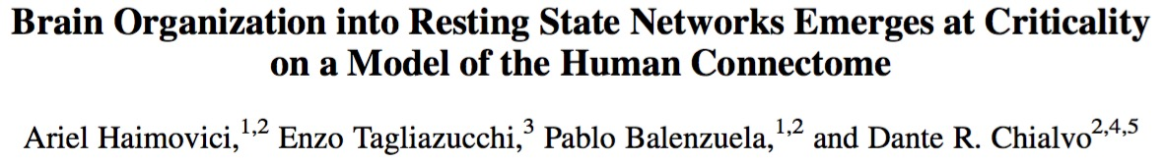
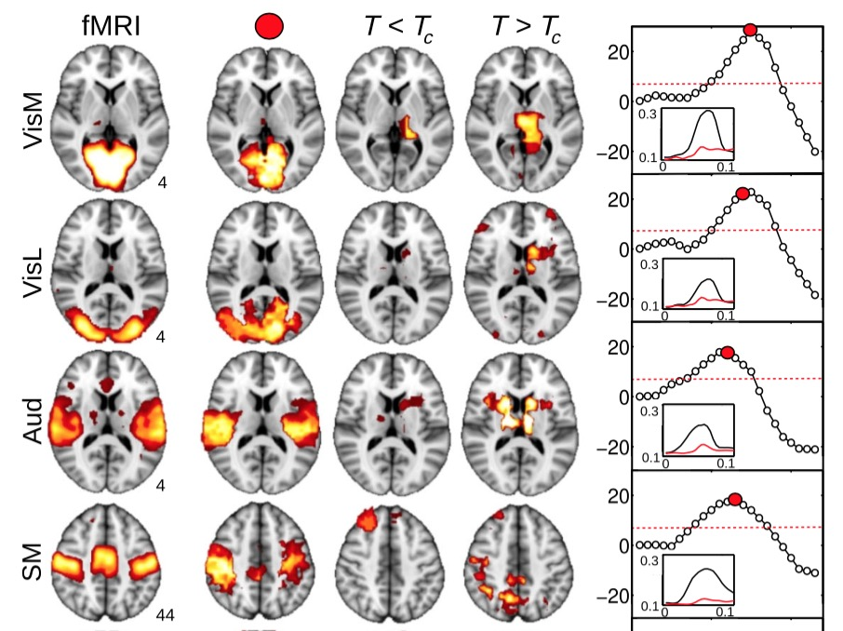
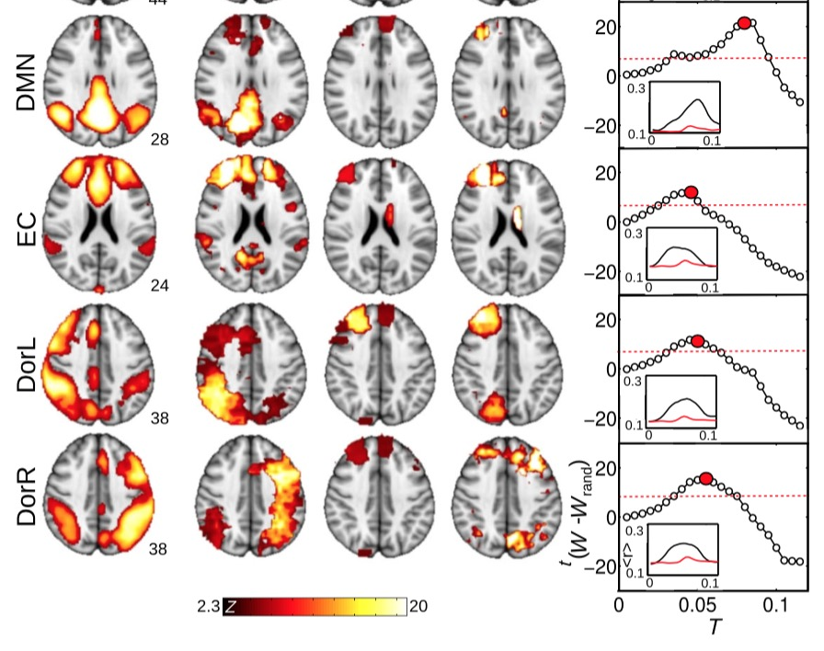
Background: dynamics
Phys. Rev. Lett. 2013
see also Kitzbichler et al. PLoS Comp. Biol. 2009

Slide 8

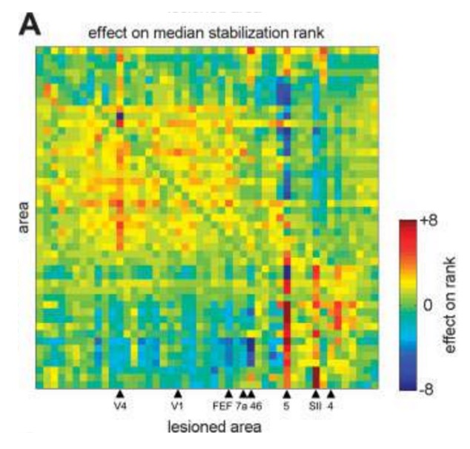
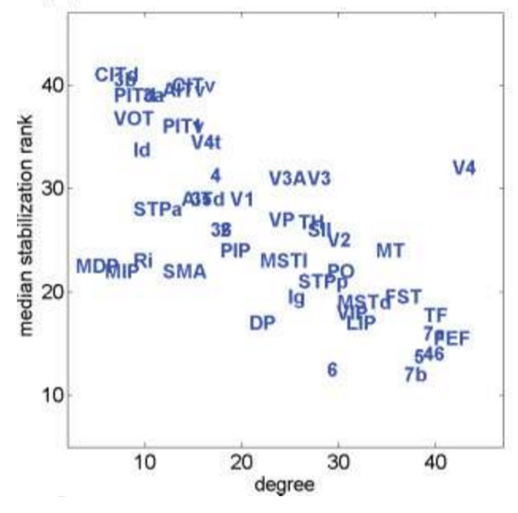
Background: virtual lesions
Hum. Brain Mapp. 2008

Slide 9
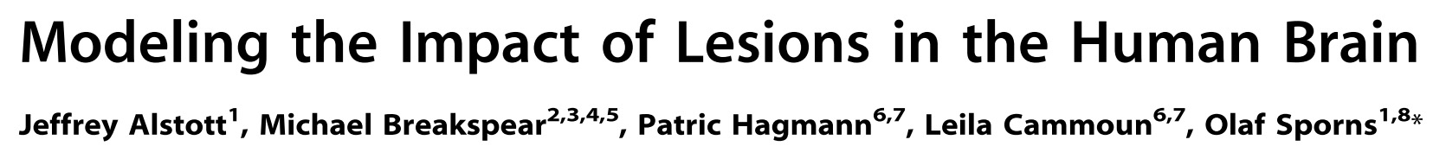
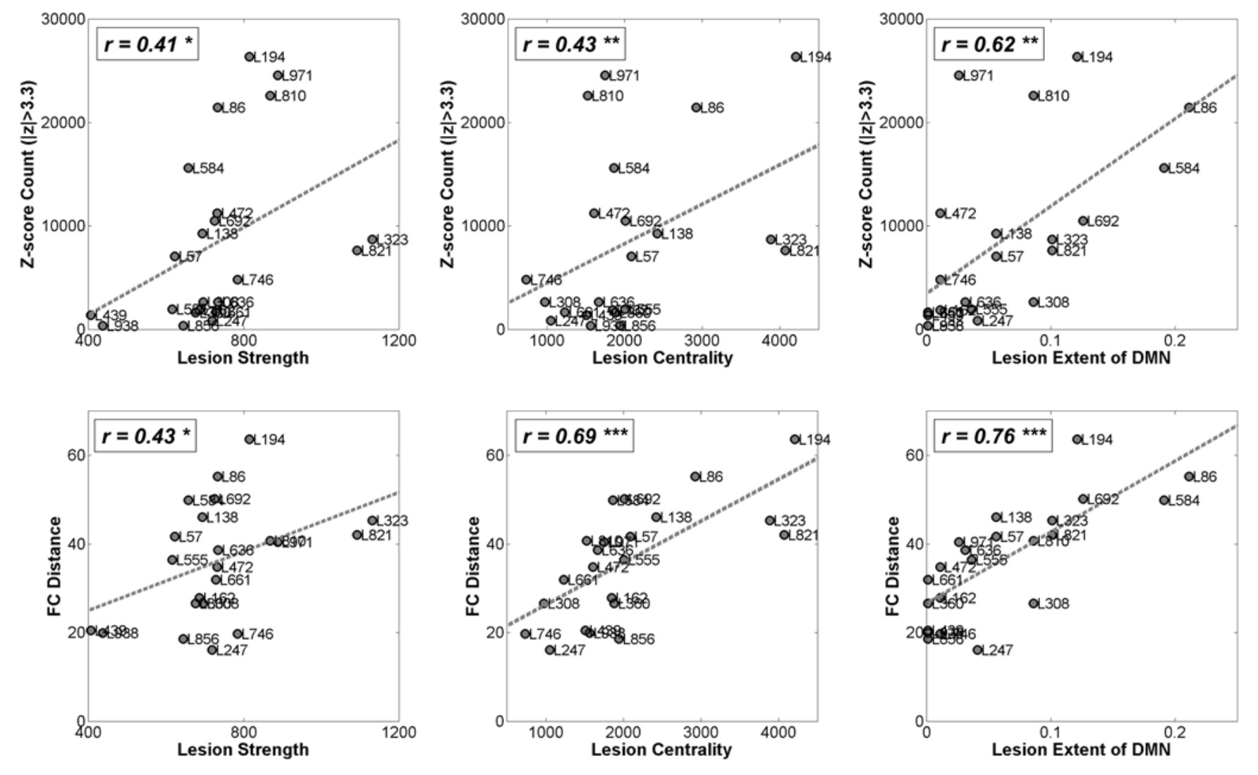
Background: virtual lesions
PLoS Comp. Biol. 2009
importance of lesioned nodes
impact on simulated FC

Slide 10
Aims
Q: What is the relationship between the structure of the connectome and (the metastability of) its dynamics?
Calibrate Kuramoto model to match empirical fMRI data
Relate structure to dynamics using virtual lesions
(weak) Hypotheses
Structural importance of a node should relate to dynamical changes resulting from its removal
Effects of lesions most important in neighbourhood of lesioned node
+ unexpected relationship to several empirical studies…

Slide 11
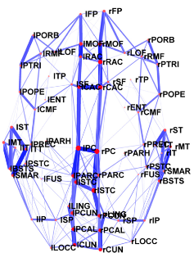
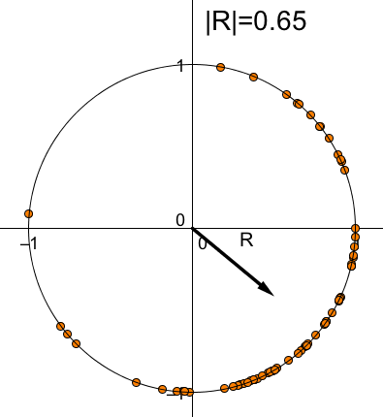
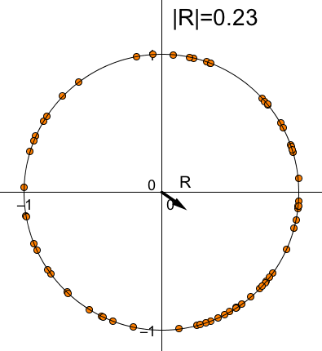
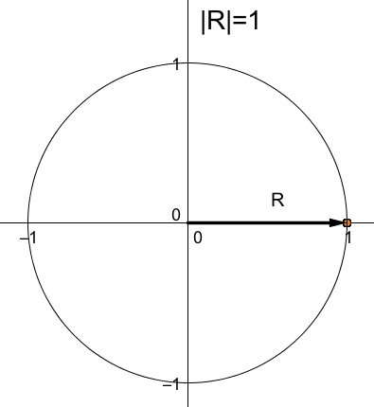
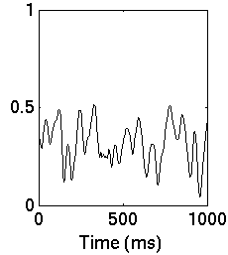
Kuramoto oscillator model of neural synchrony (Kuramoto 1984)
Hagmann et al. (PLOS Bio. 2008)
inputs / parameters
Dynamics:
Order parameter R(t)
MATLAB, Euler method
Conditions:
Uniform → ωi = 60 Hz for all i
Noisy → ωi - N(60,3) Hz + noise ηi = N(0,2) rad.
phase: oscillator state
(0 < θ ≤ 2π )
coupling: → mean k
delay: → mean τ
frequency: periodic γ (60Hz) oscillations
|R(t)|
Shanahan (Chaos 2011)
Notes:
phase: state of node (relative to others)

Slide 12
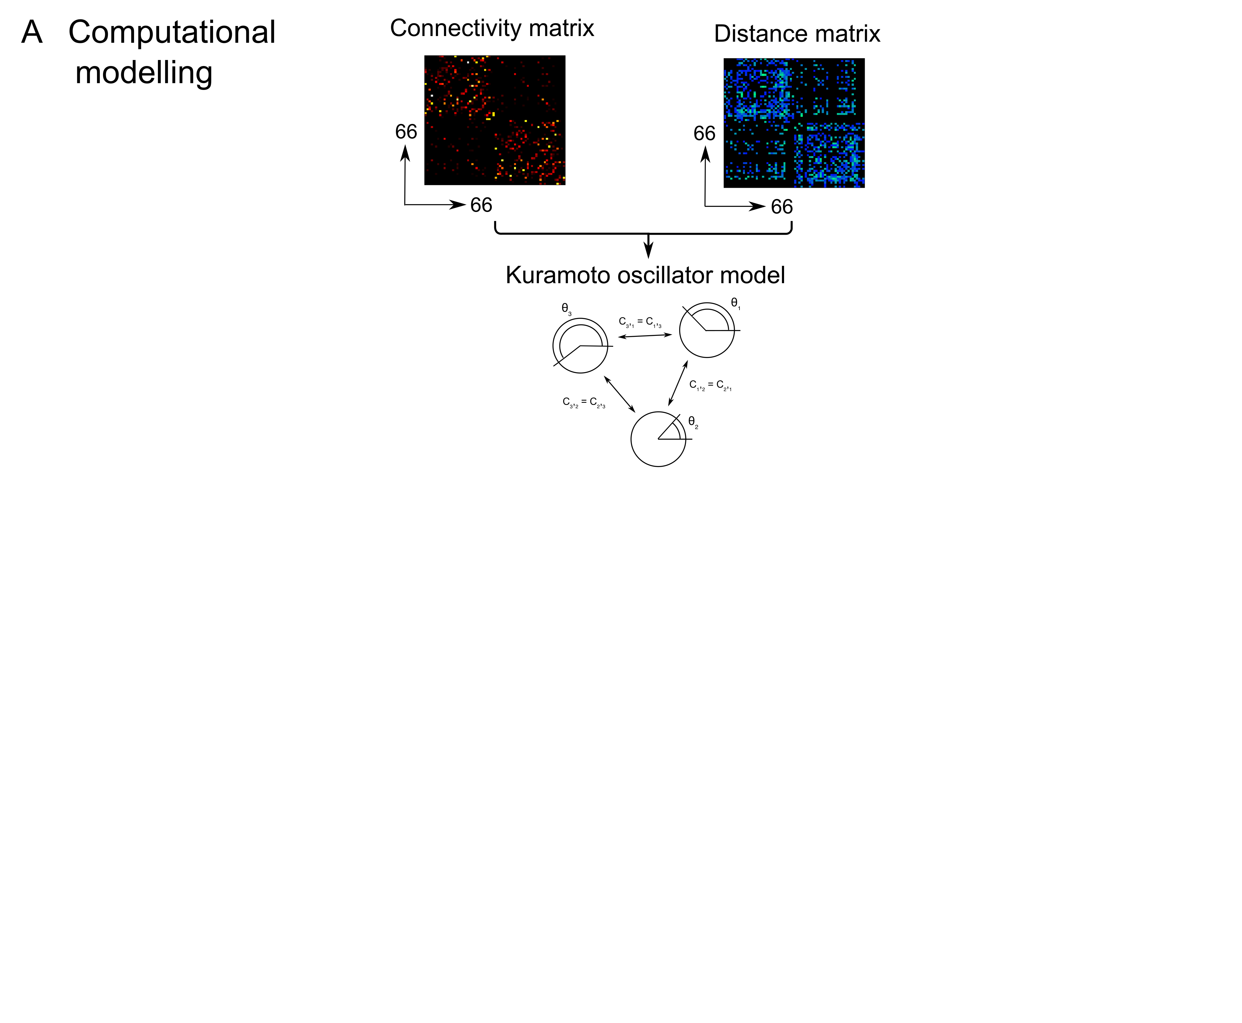
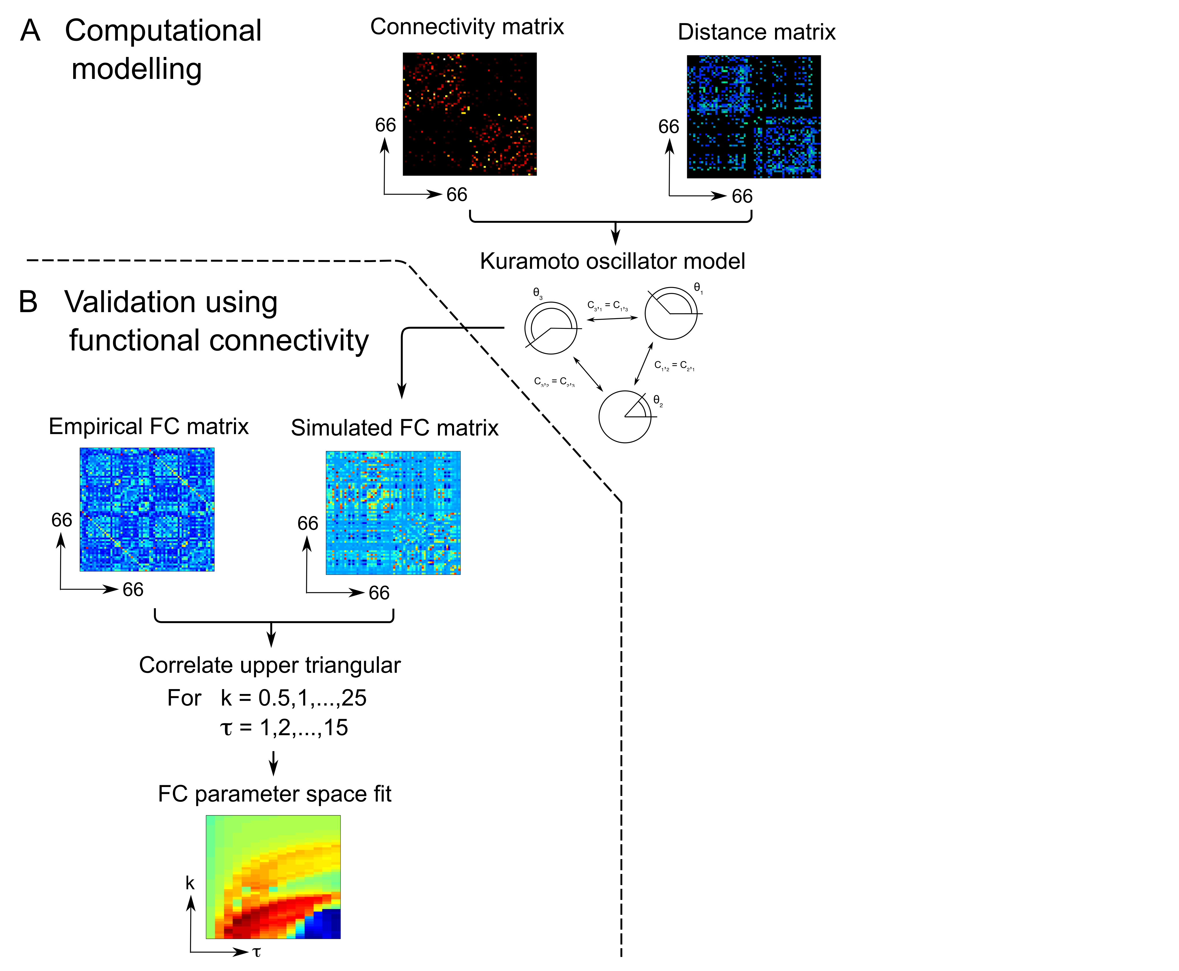
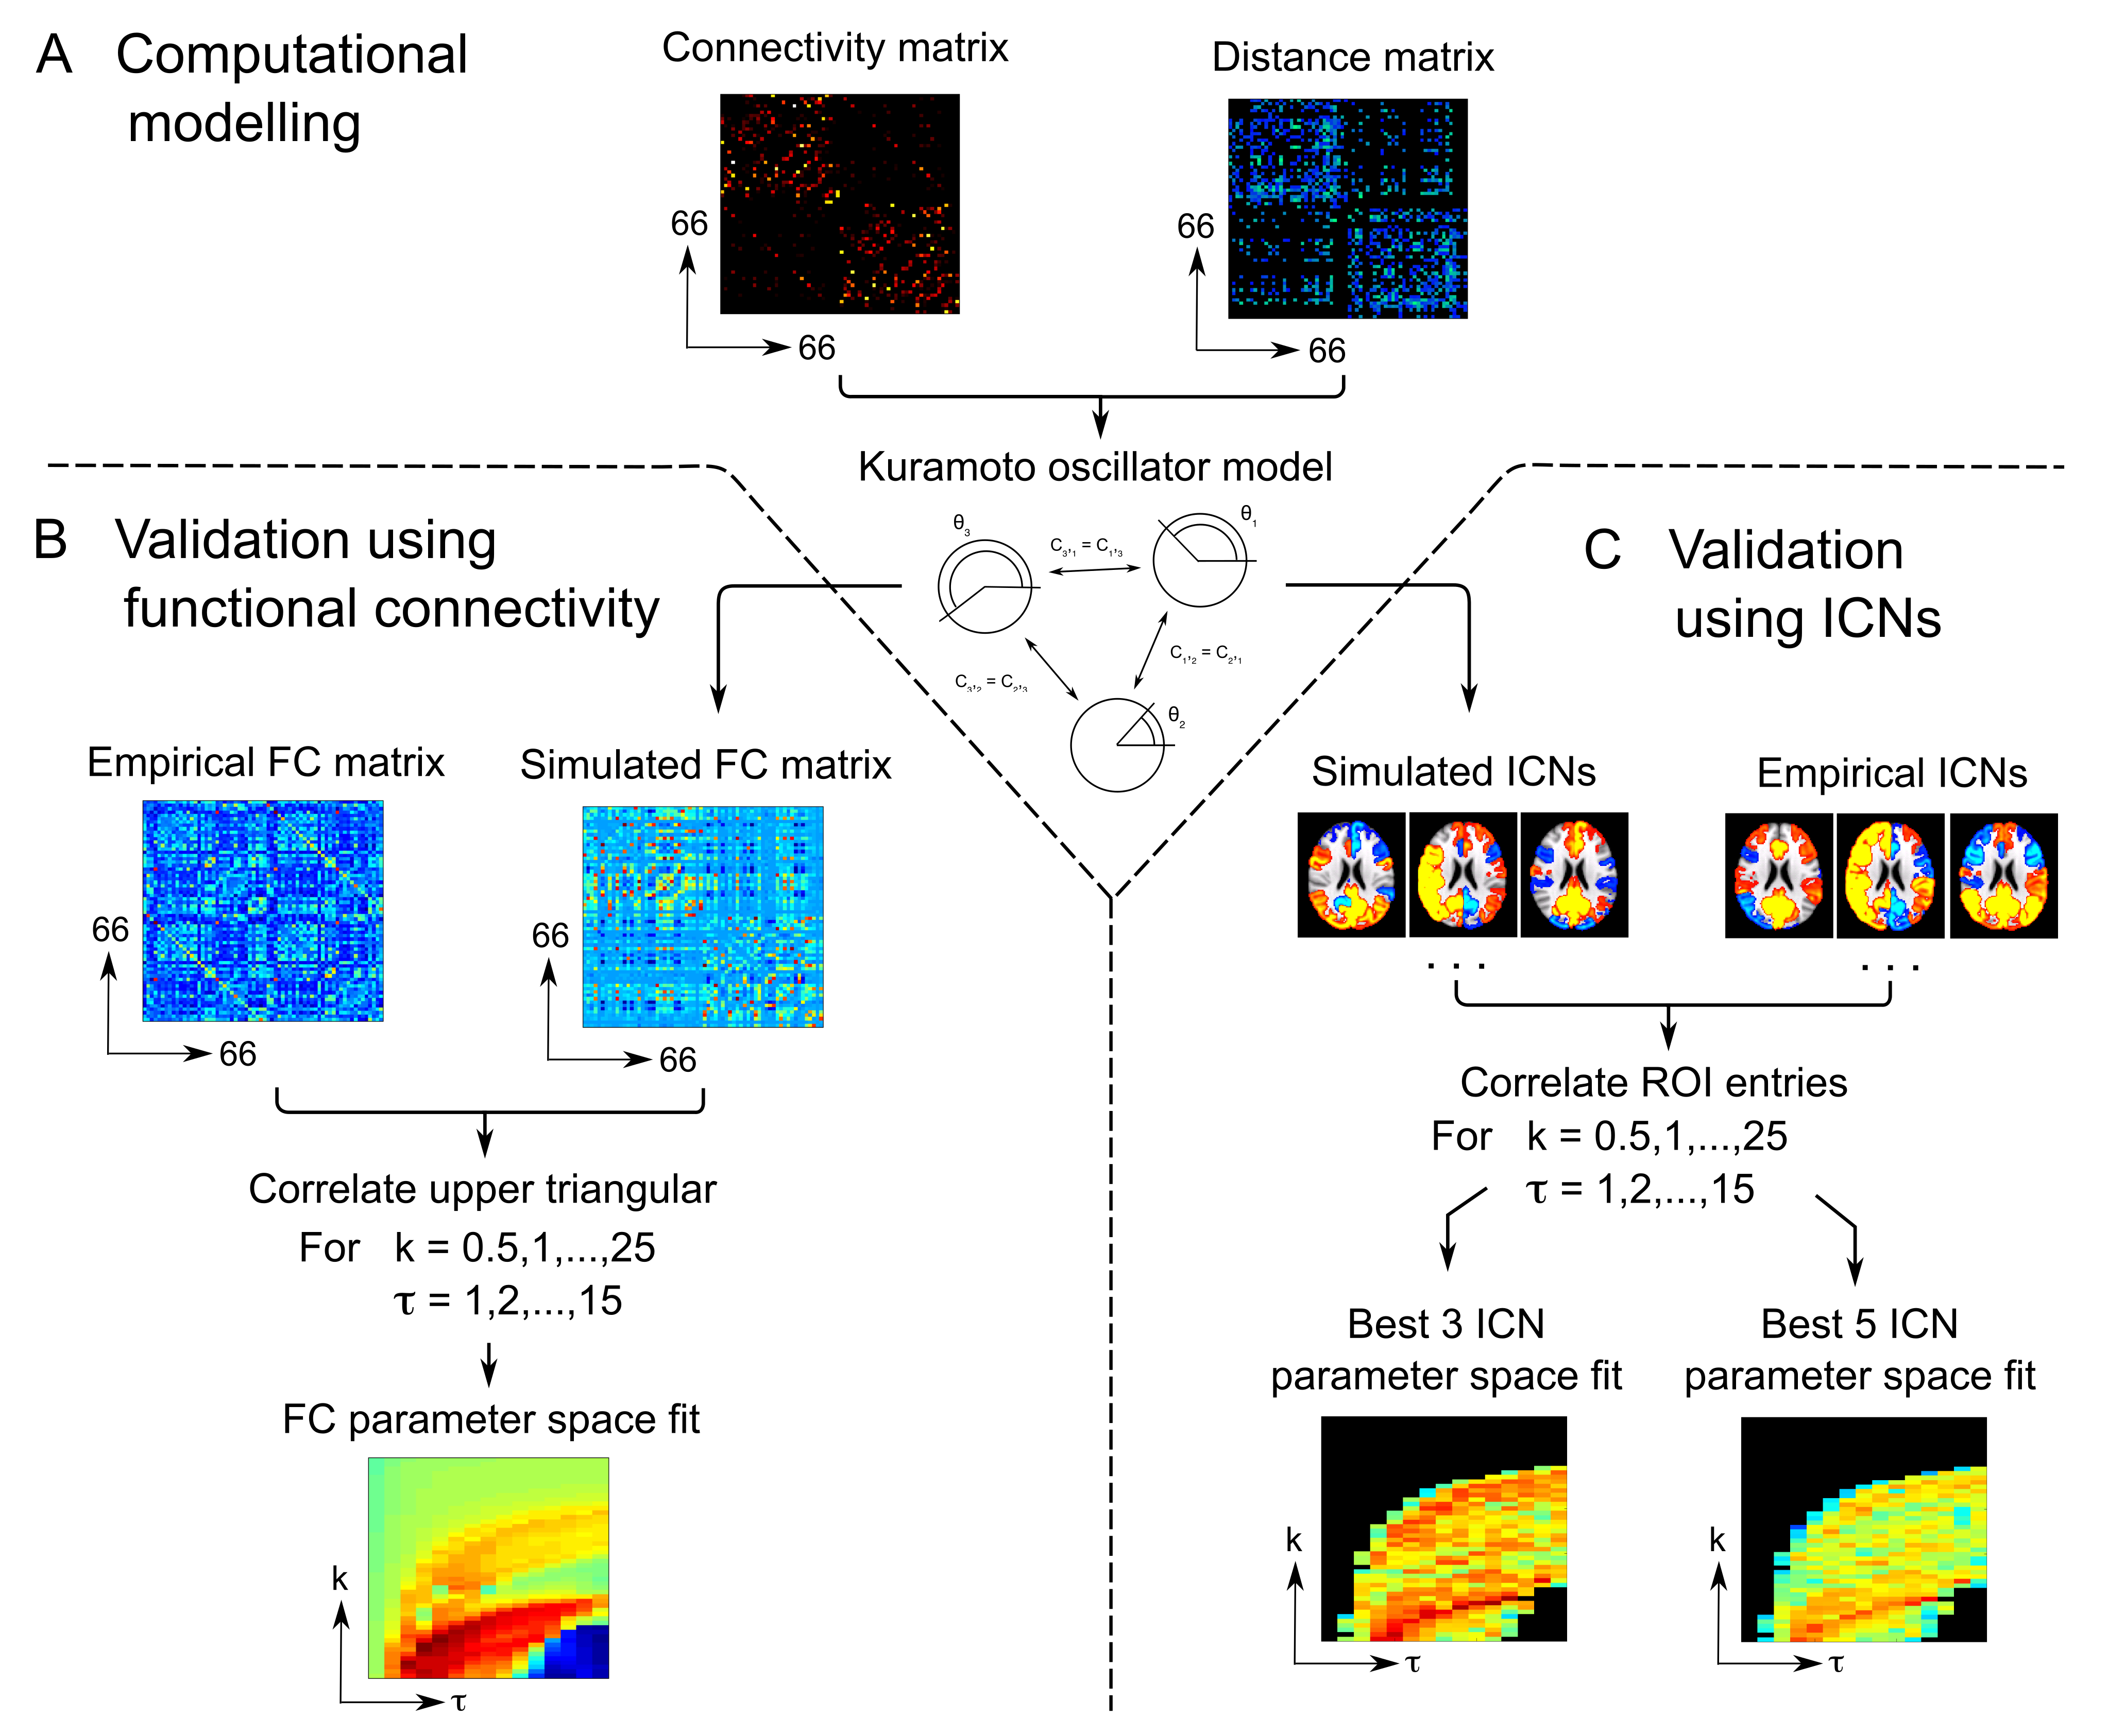
Model validation (calibration)

Slide 13
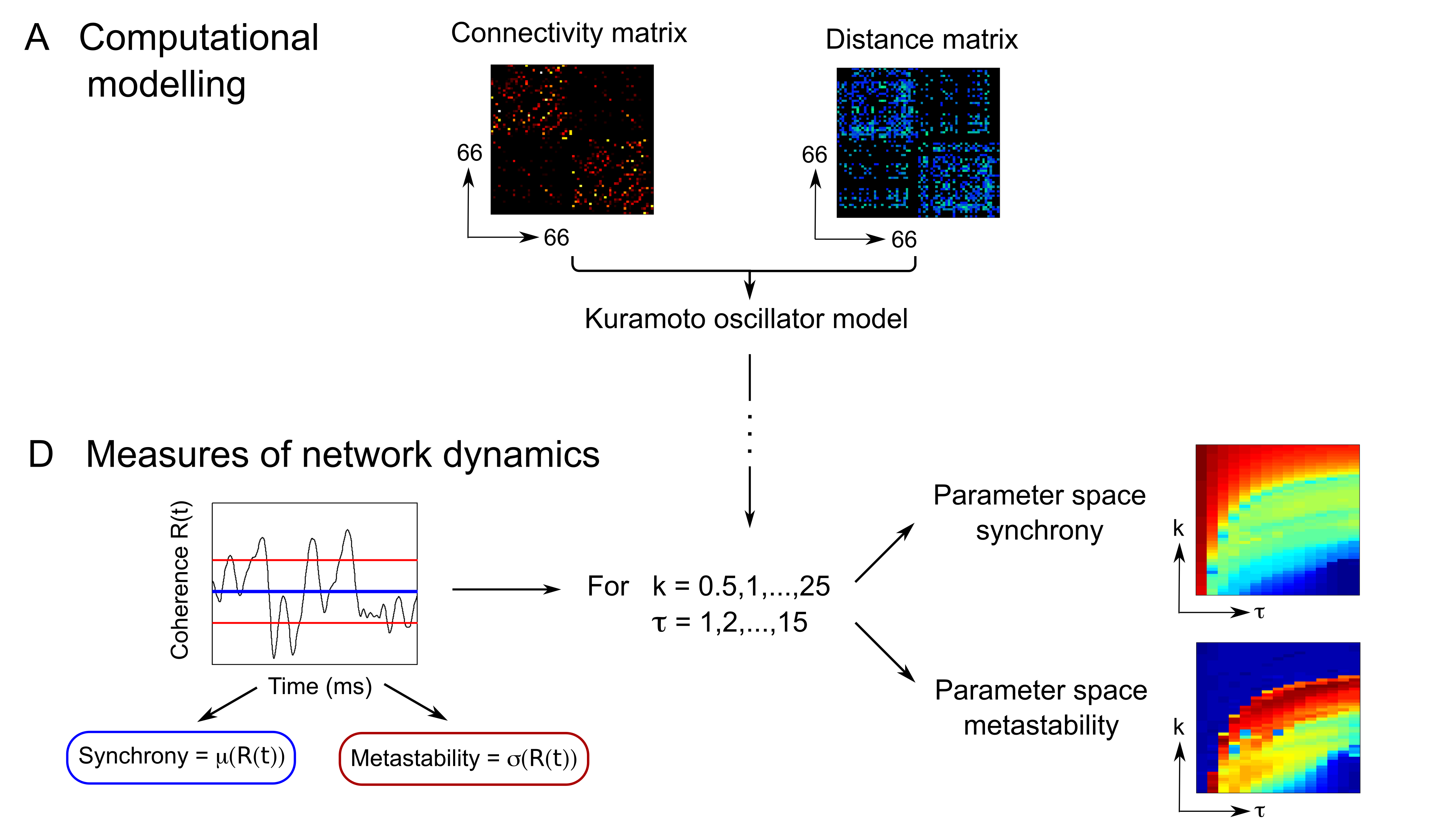
Model dynamics

Slide 14
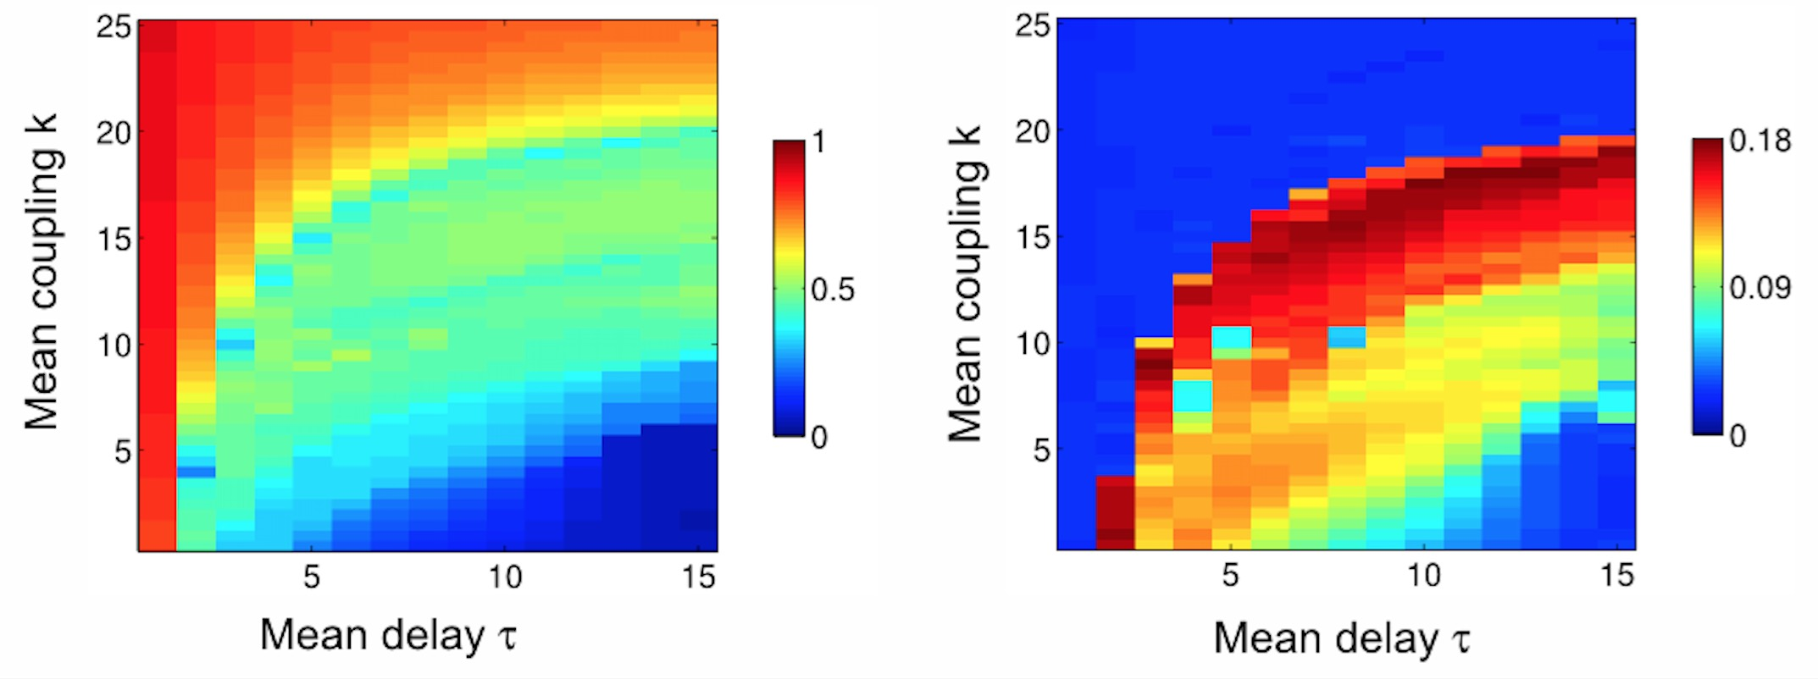
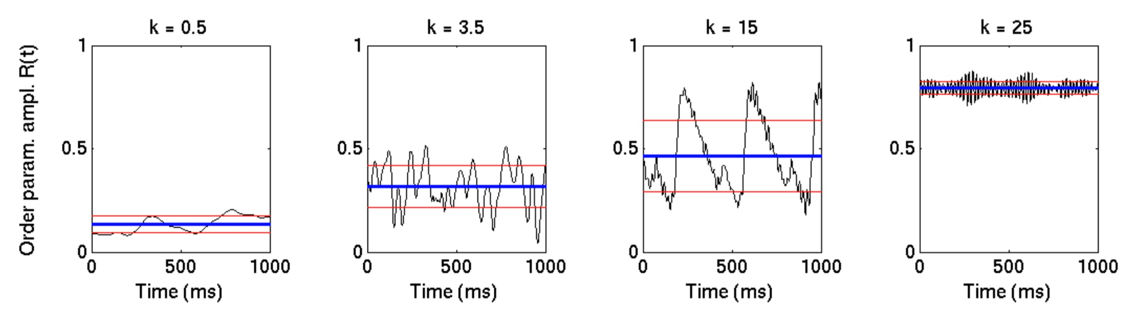
Model behavior along k axis
synchrony
metastability

Slide 15
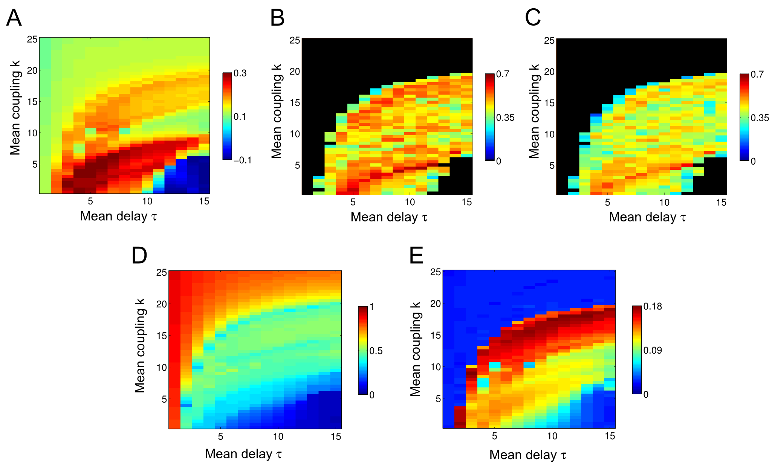
Model behavior across parameter space
pairwise FC
best 3 ICNs
best 5 ICNs
synchrony
metastability

Slide 16
Working point
Working point:
k = 3.5 , τ = 7 ms

Slide 17
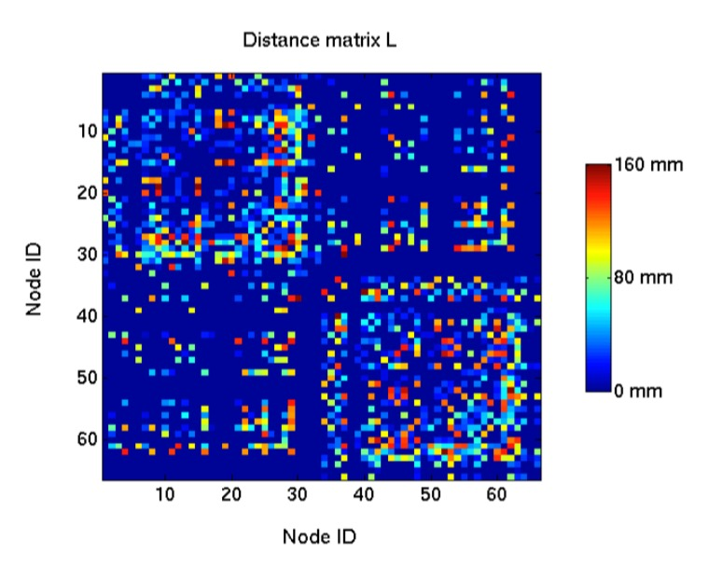
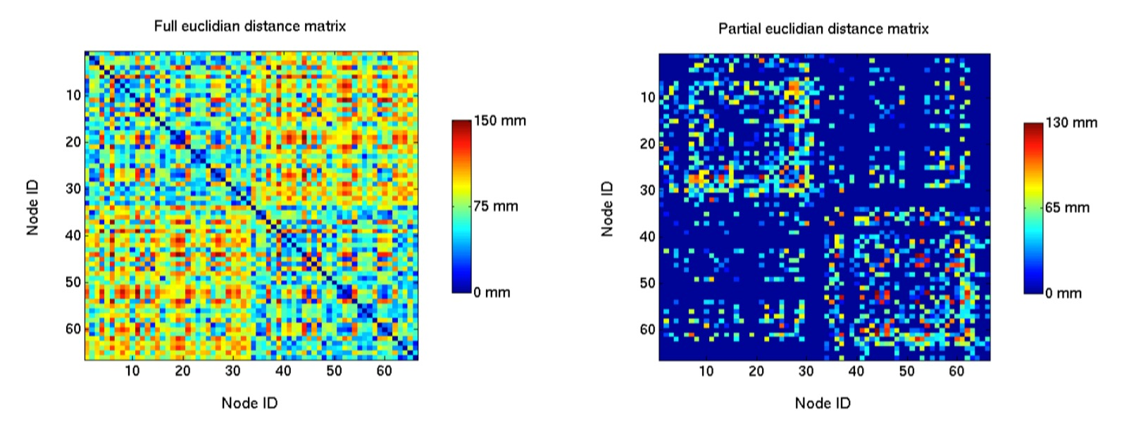
Null model – random network dynamics
Pearson r = 0.72 (p < 10⁻¹⁰)

Slide 18
Reminder - Aims
Q: What is the relationship between the structure of the connectome and (the metastability of) its dynamics?
Calibrate Kuramoto model to match empirical fMRI data
Relate structure to dynamics using virtual lesions
✓
➔
(weak) Hypotheses
Structural importance of a node should relate to dynamical changes resulting from its removal
Effects of lesions most important in neighbourhood of lesioned node

Slide 19
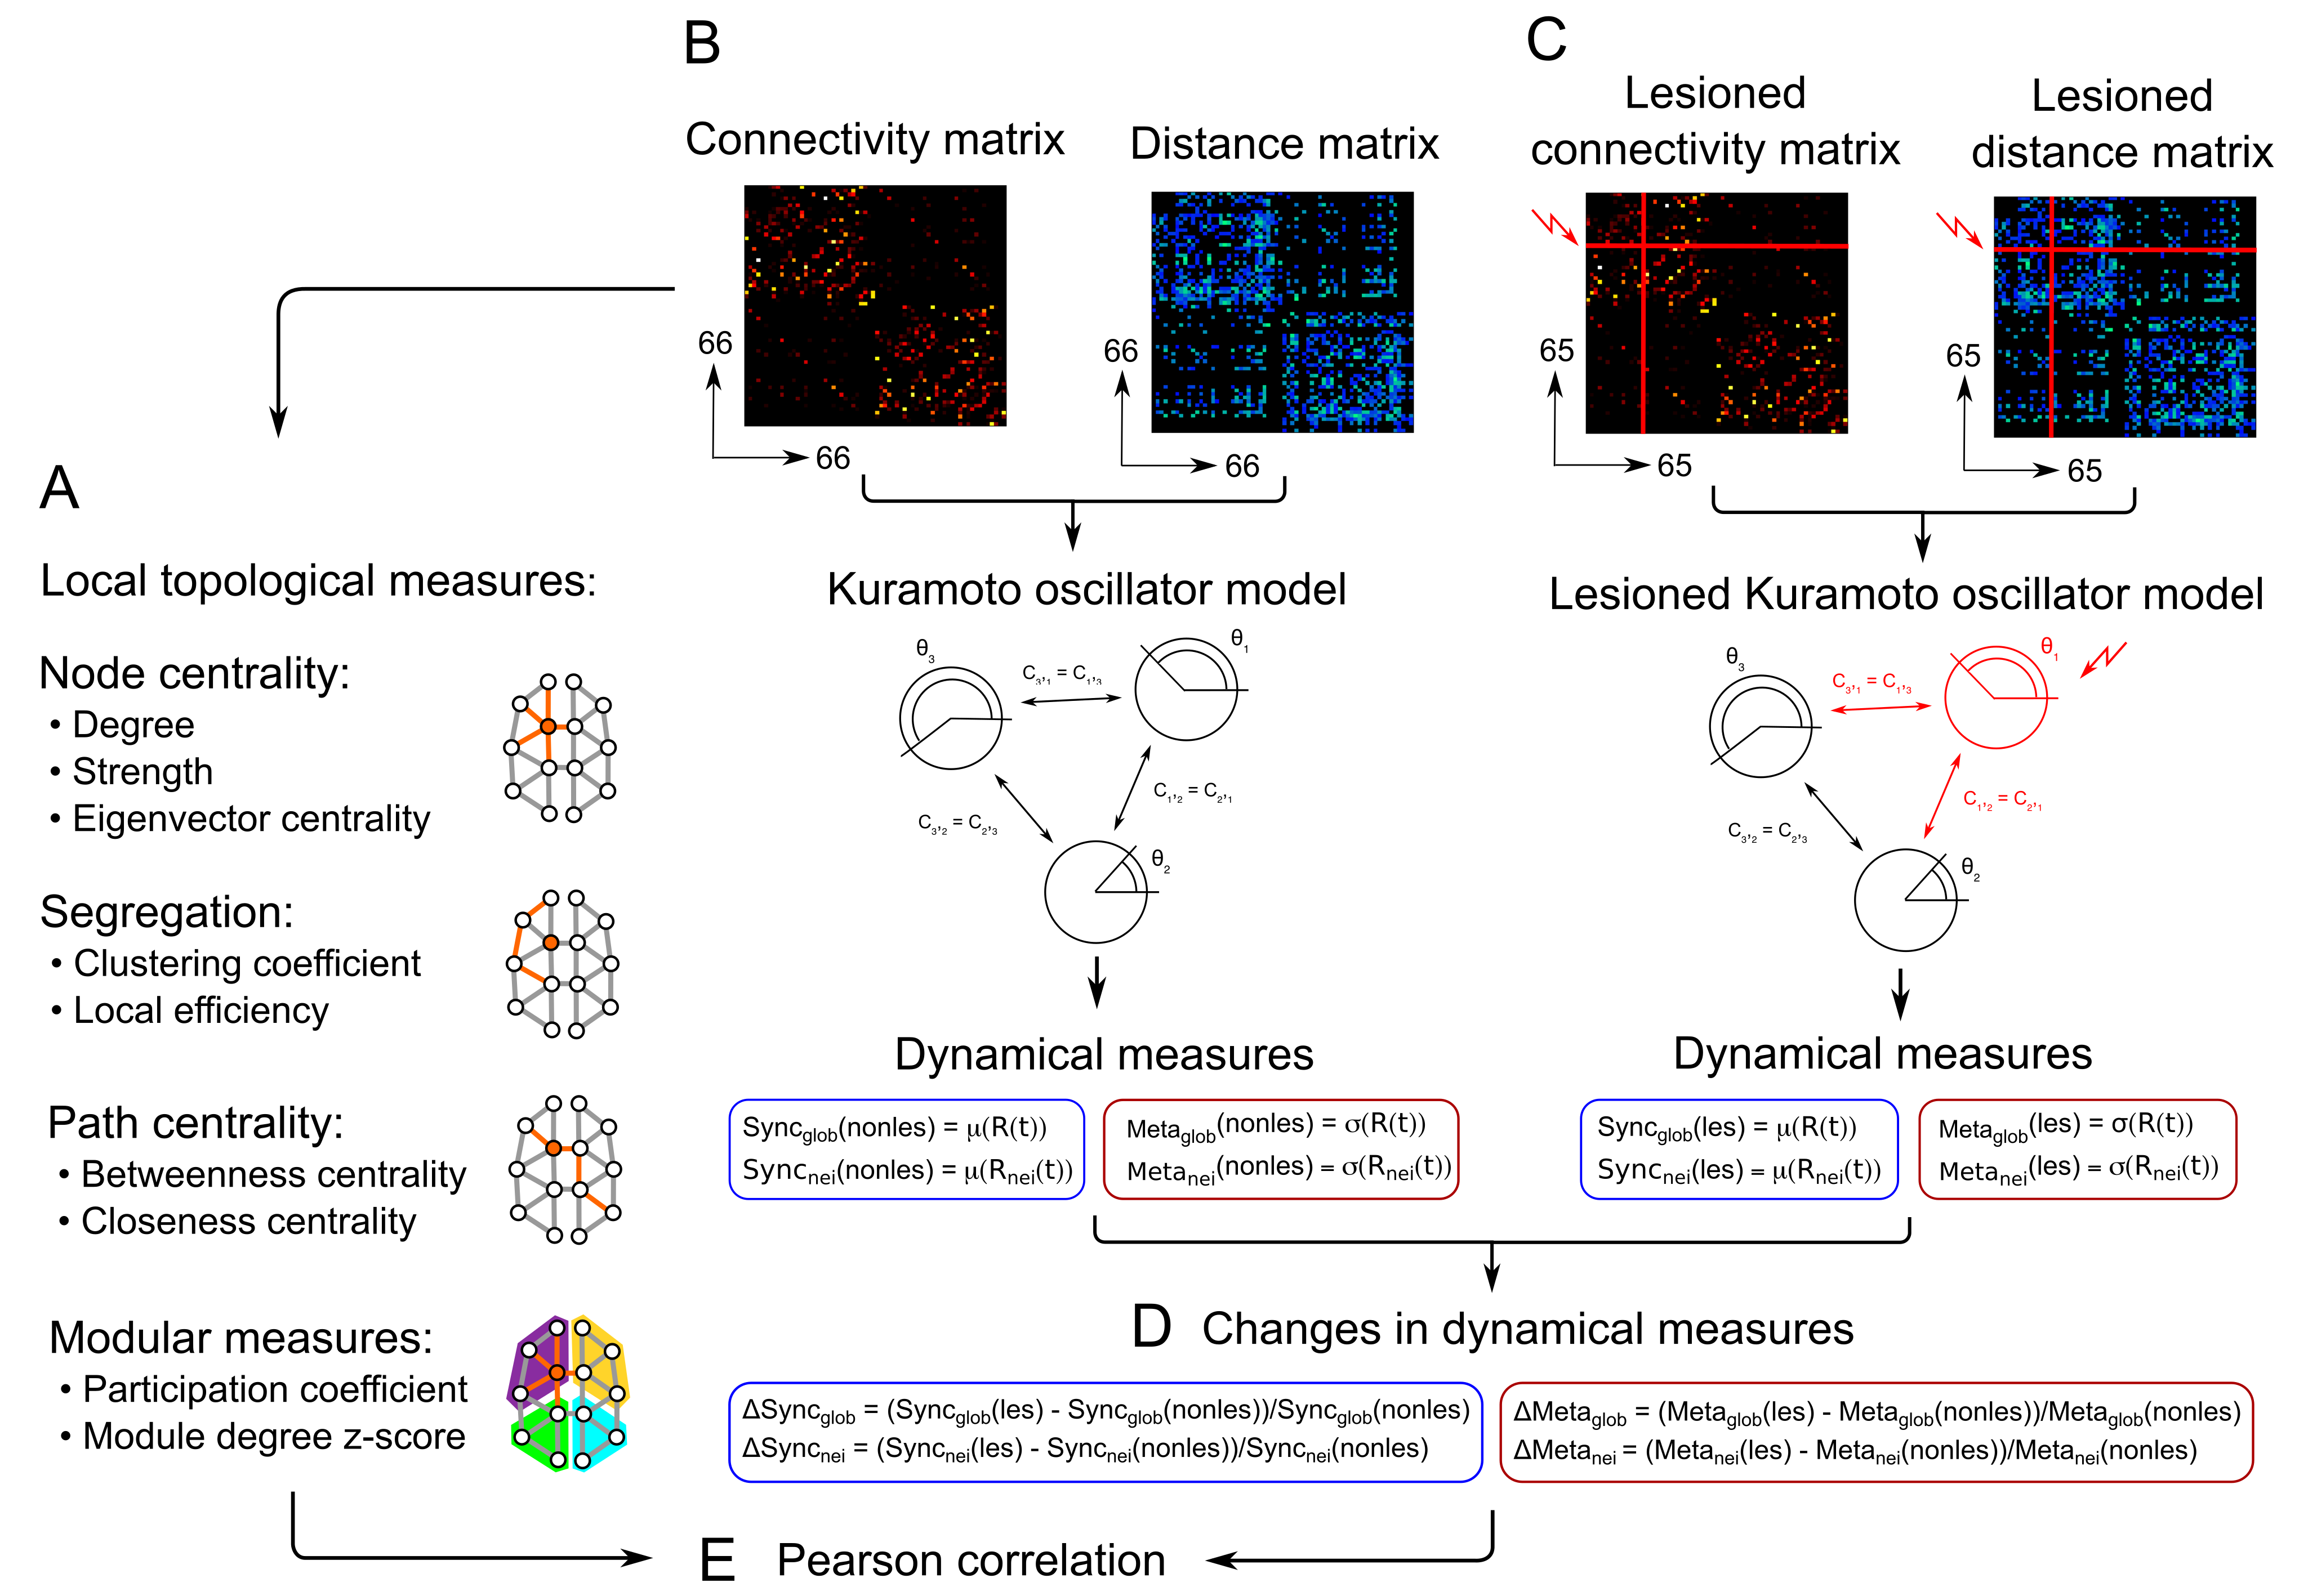
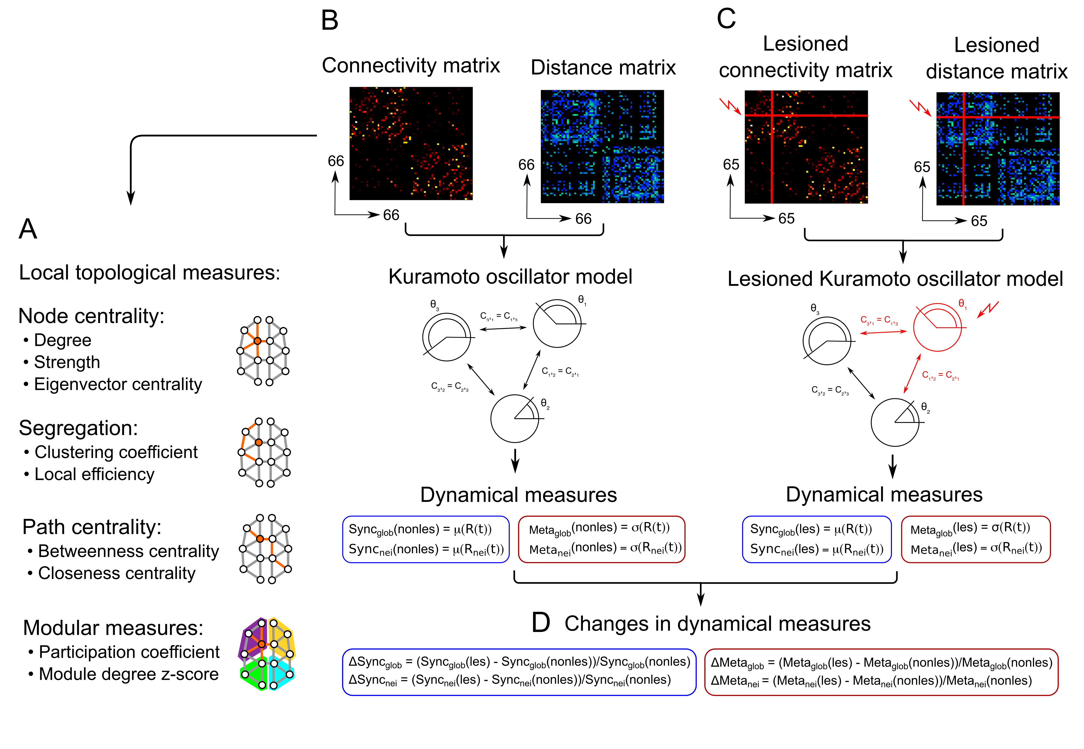
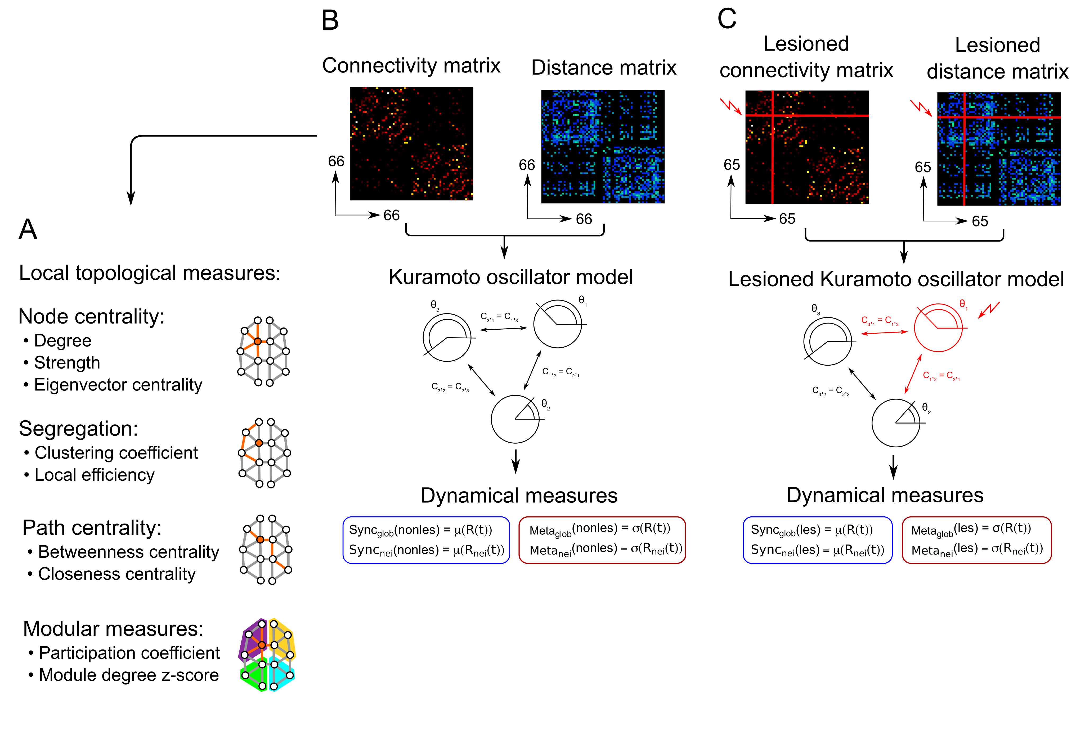
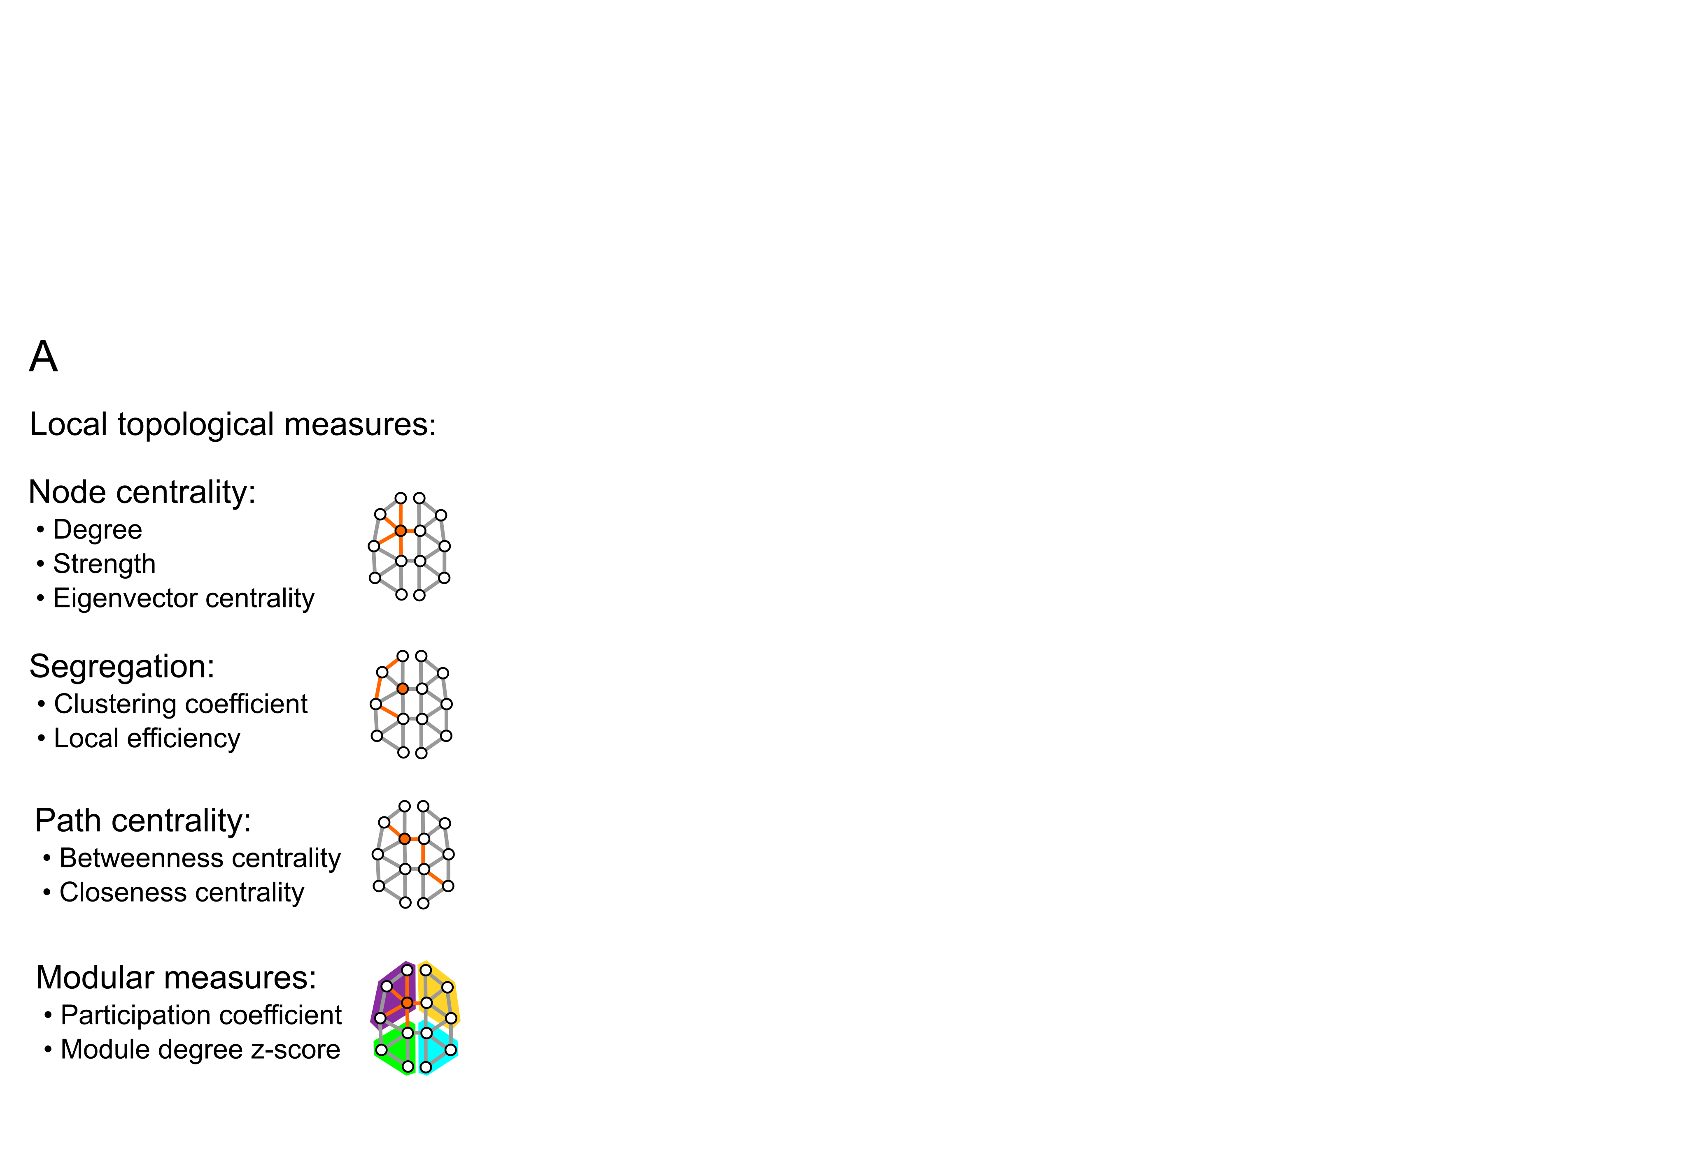
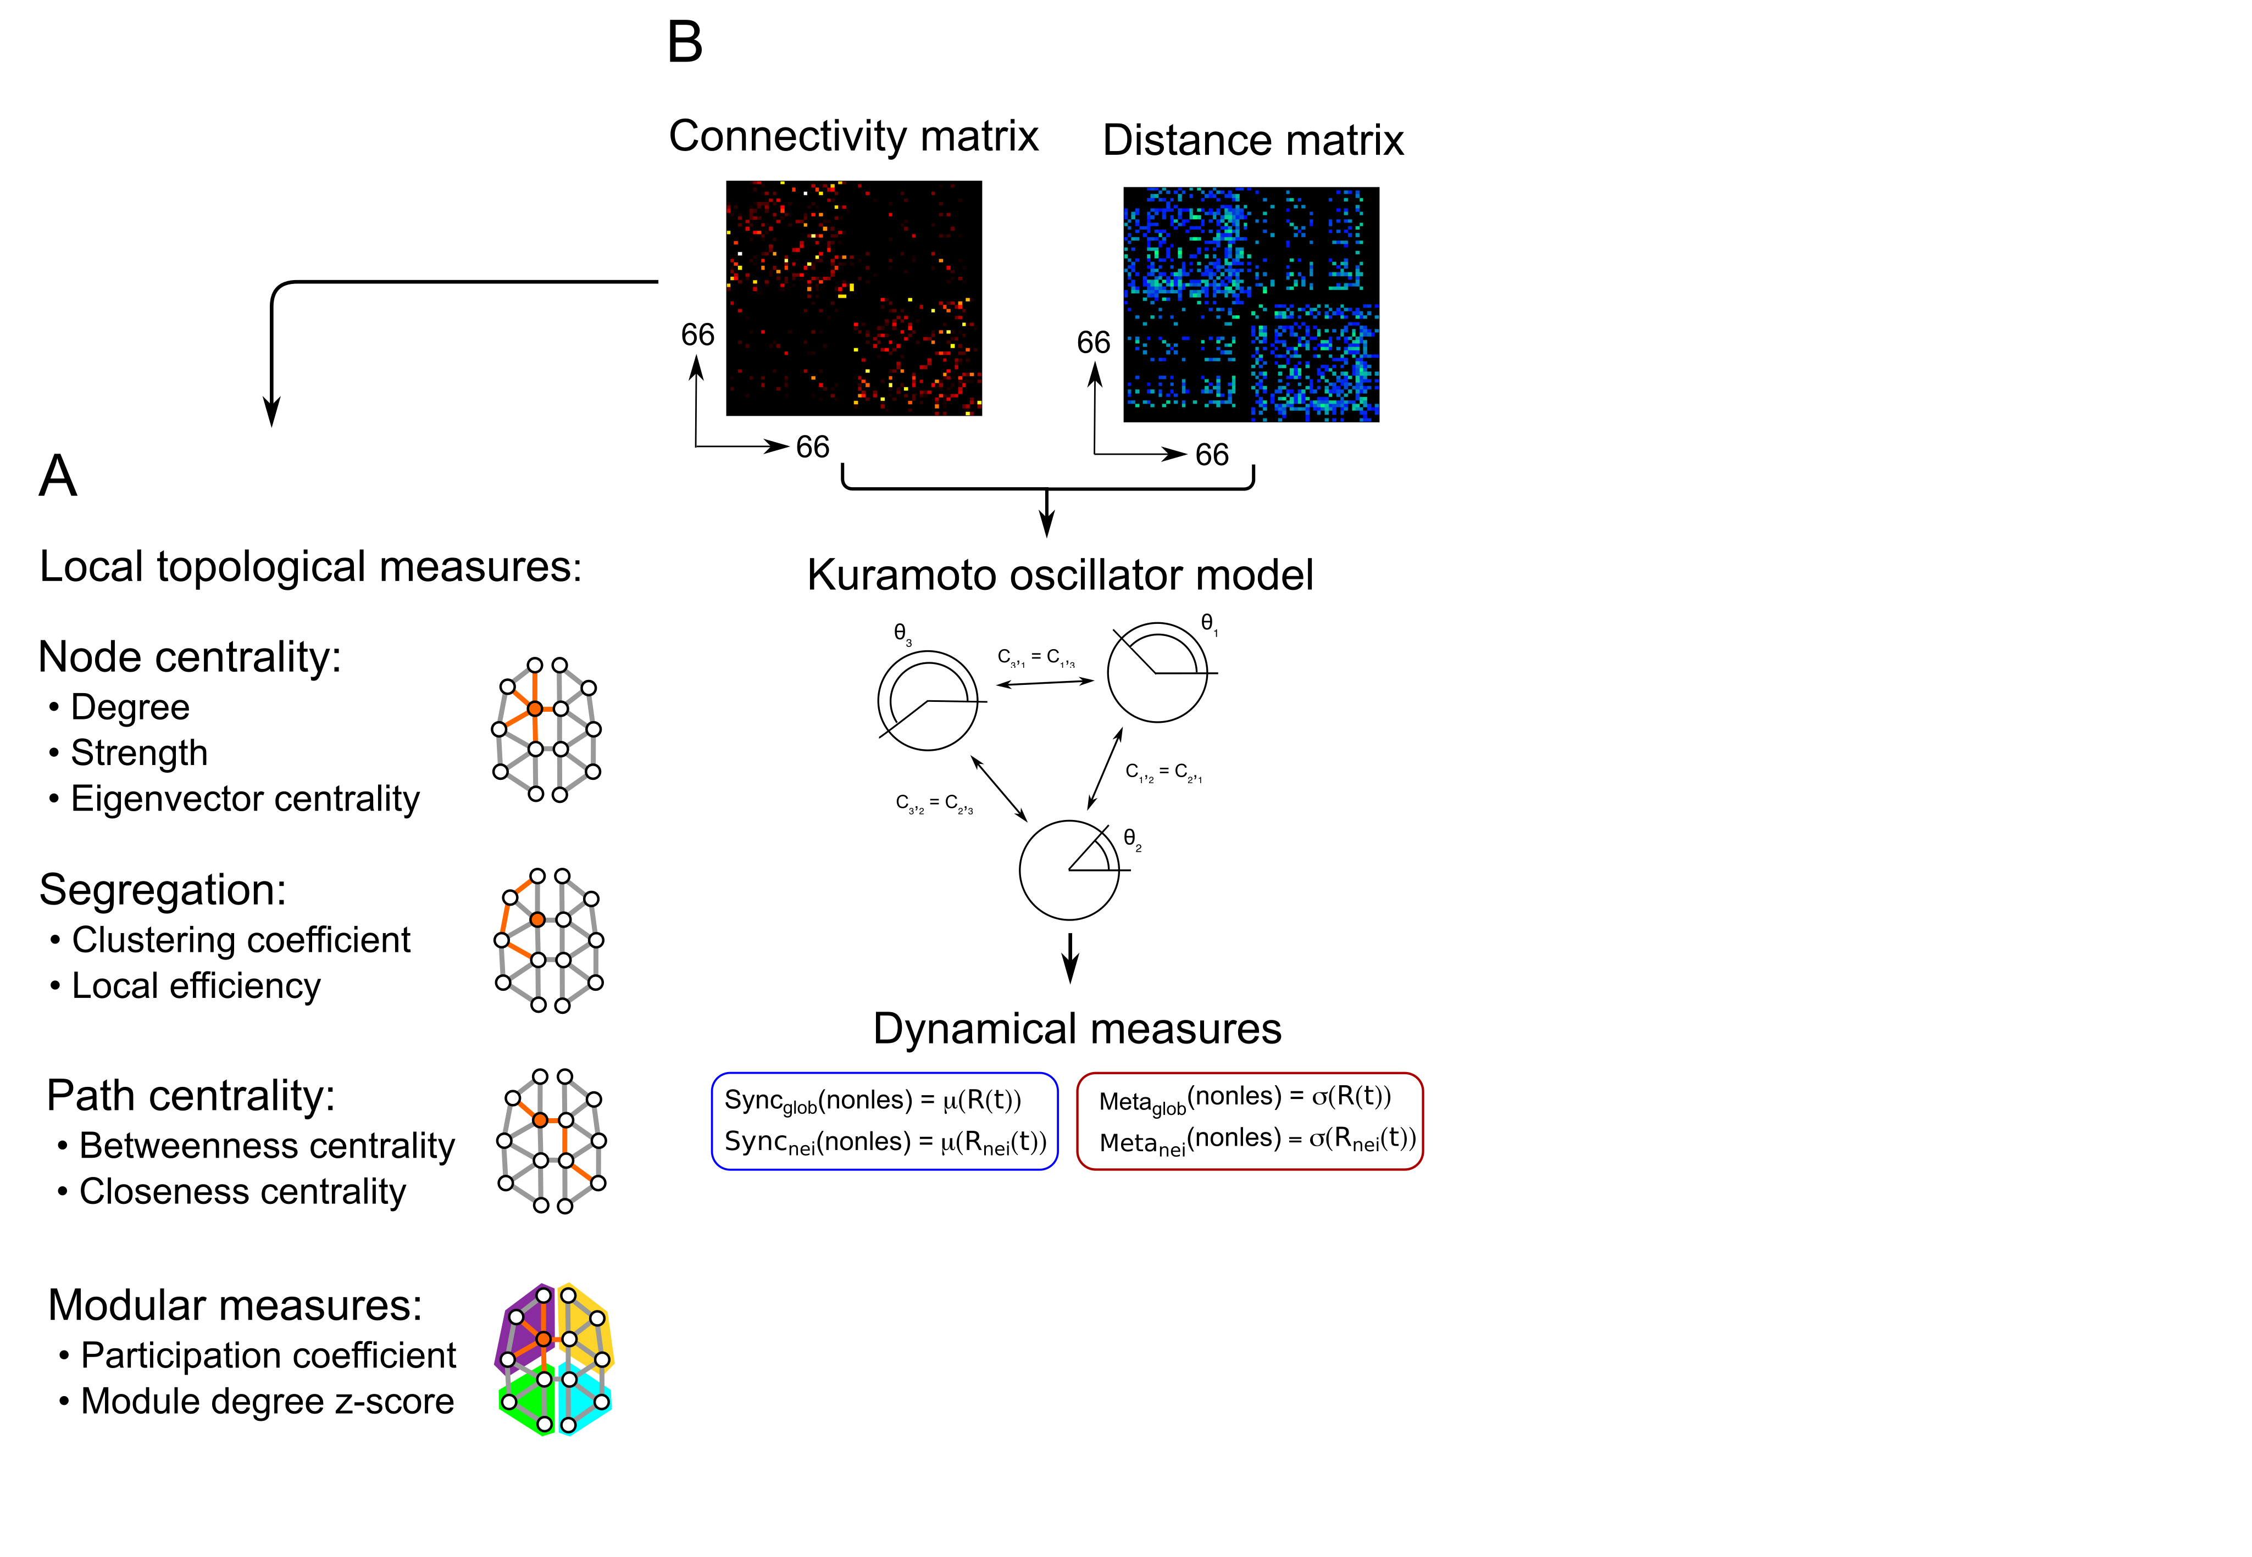
Effects of lesions

Slide 20
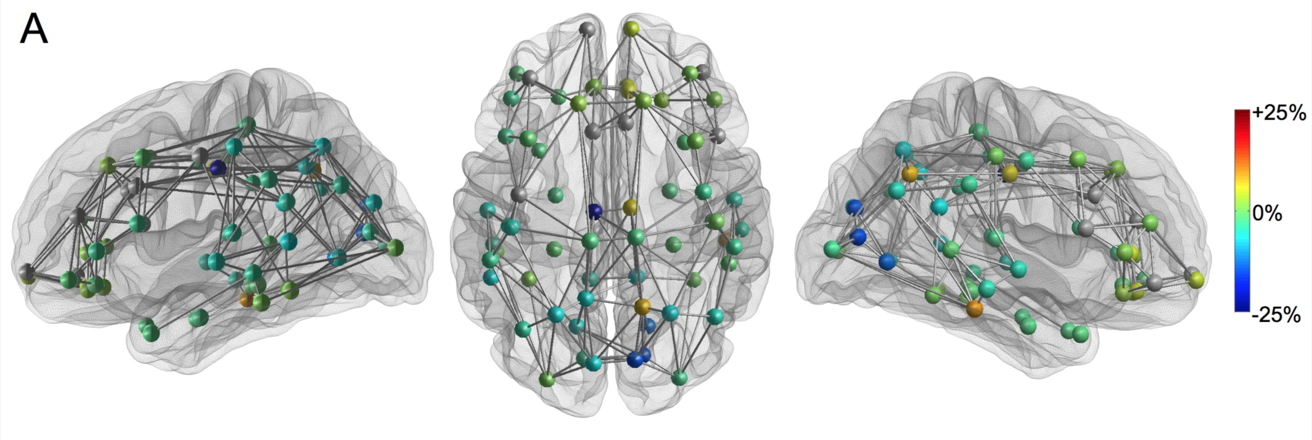
Post-lesion ∆ synchrony
Global: 𝛍 [95% CI] = -1.7 [-3.0,-0.4] % (two-tailed T-test p = 0.017)
Neighbourhood: 𝛍 [95% CI] = -5.1 [-7.1,-3.1] % (two-tailed T-test p = 3.5･10⁻⁶)

Slide 21
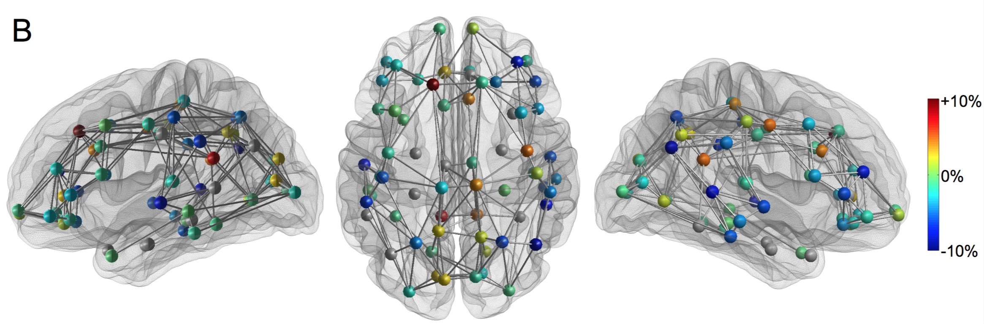
Post-lesion ∆ metastability
Global: 𝛍 [95% CI] = -0.9 [-1.8,-0.05] % (two-tailed T-test p = 0.035)
Neighbourhood: 𝛍 [95% CI] = +1.7 [-1.8,-0.05] % (two-tailed T-test p = 0.21)

Slide 22
Structure VS ∆dynamics
global
neighbourhood
f
f
plot title = Pearson r (p)

Slide 23
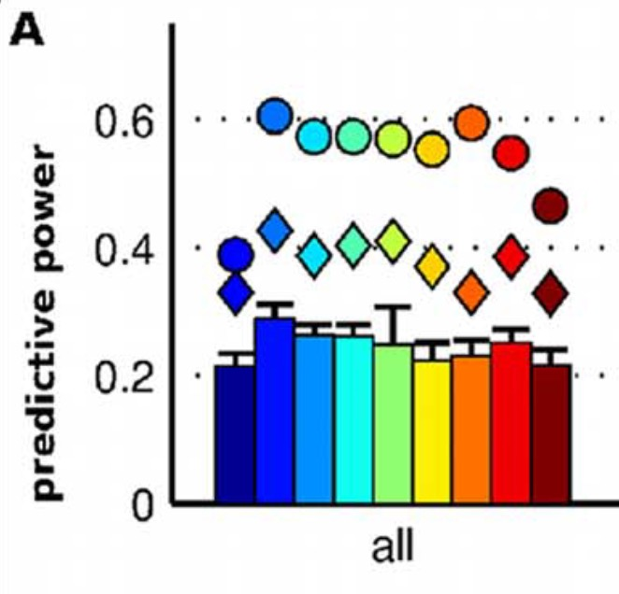
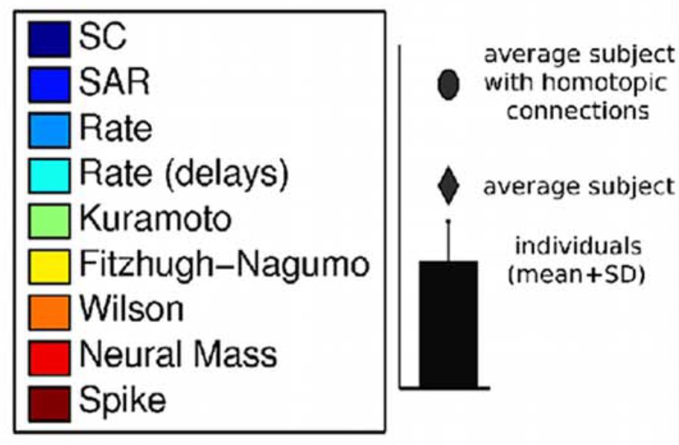
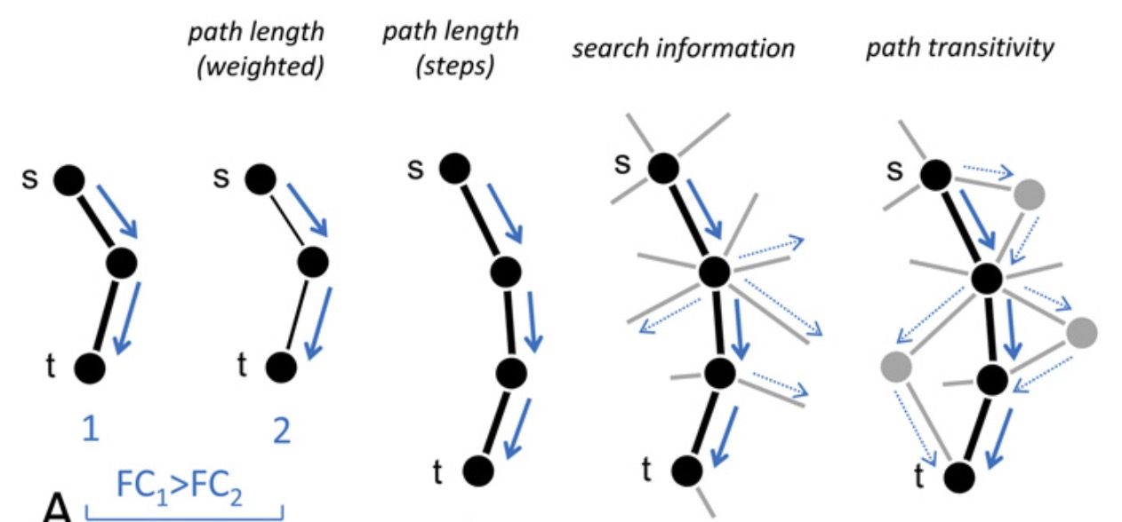
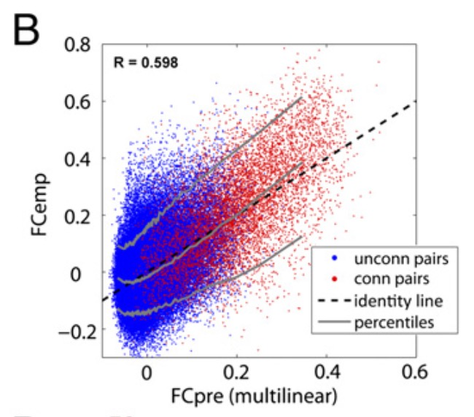
Fit between model and empirical data
Messé et al.
PLoS Comp. Biol. 2014
Deco et al. J. Neurosci. 2014
“A dramatic improvement of the fitting of the matrices was obtained with the addition of a small number of anatomical links, particularly cross-hemispheric connections”
Goñi et al. PNAS 2014

Slide 24
Role of structural topology in shaping function
Strength, eigenvector cent. predicitive of ∆ dynamics; degree is not.
perturbing high-degree nodes affects dynamics most (Honey & Sporns HBM 2008)
structural degree important predictor of FC (Tewarie et al. NeuroImage 2014)
BUT both studies used binary structural connectomes
model correspondence to FC_{emp} + metastability destroyed if:
topology is randomised
connections are made equally important
Eigenvector centrality, participation coefficient strongest predictors
Likely members of the rich club (RC) (van den Heuvel & Sporns J. Neurosci. 2011)
RC = anatomical substrate for transmodal integration of ICNs (RSNs)
Leech et al. J. Neurosci. 2012, van den Heuvel & Sporns J. Neurosci. 2013
Dynamics: Rich nodes → slow + stable; Periphery → fast + unstable
Gollo et al. Phil. Trans. R. Soc. B 2015
(Cabral et al. NeuroImage 2014)

Slide 25
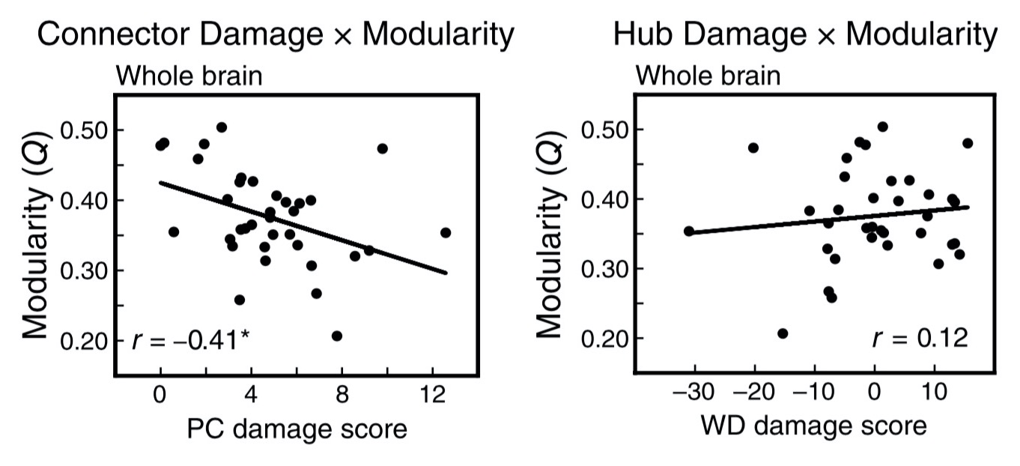
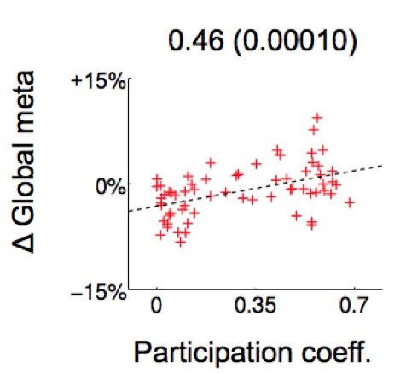
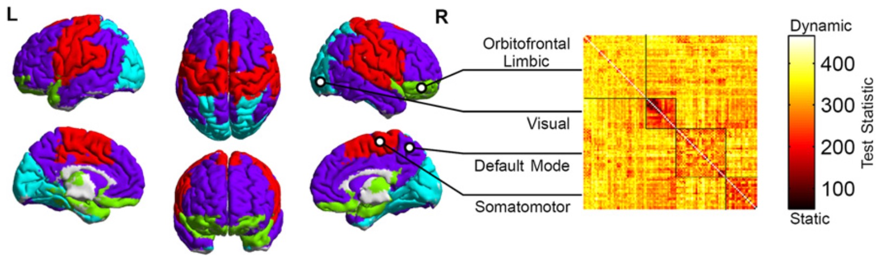
Integrative hubs, modularity and cortical dynamics
Stroke: Gratton et al. J. Cog. Neurosci. 2012
Váša et al. NeuroImage 2015
modularity VS integrative hubs
integrative hubs VS dyn. variability
modularity VS dyn. variability
Functional dynamics: Zalesky et al. PNAS 2014

Slide 26
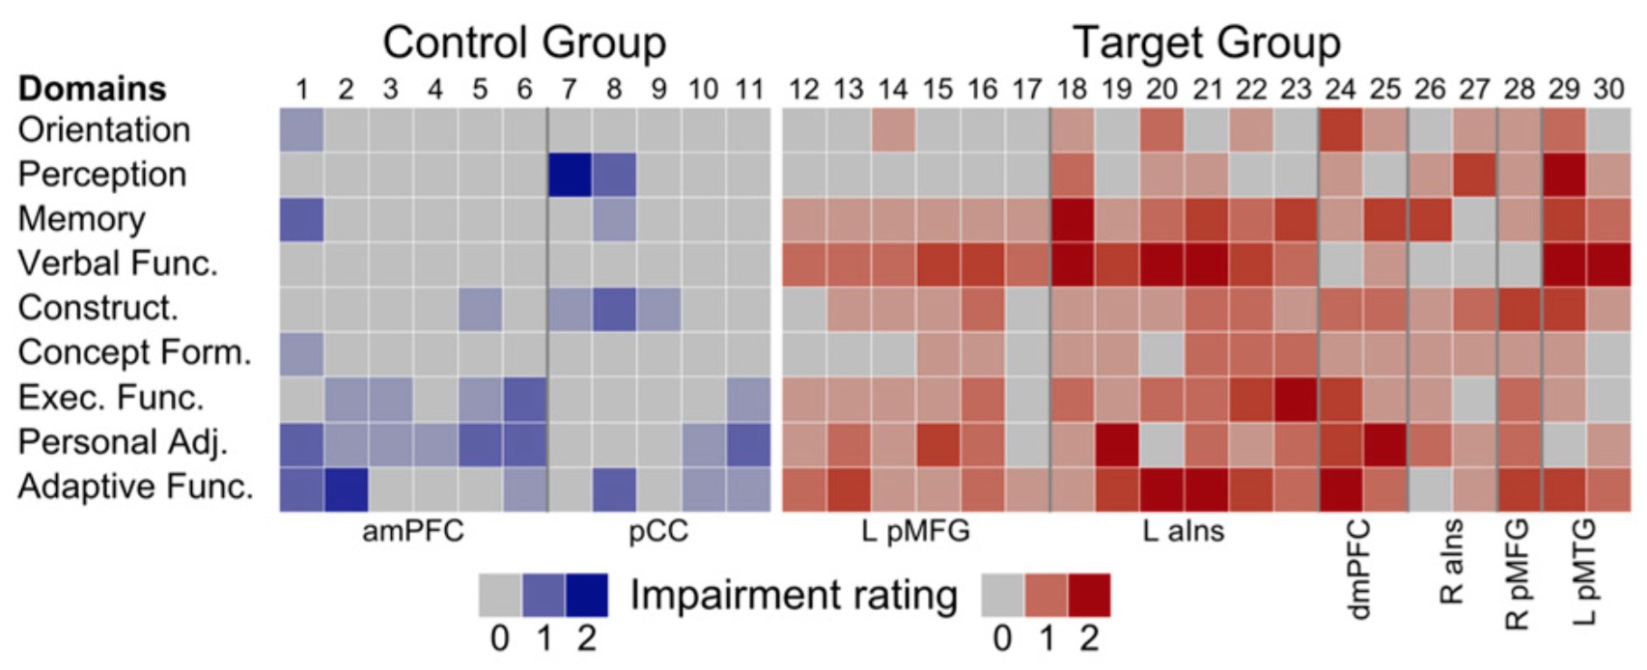
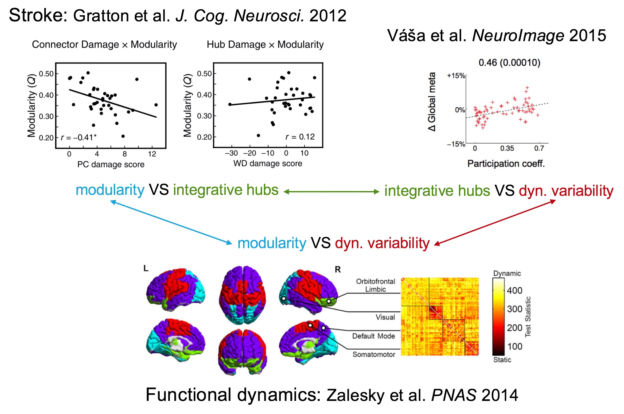
Integrative hubs, modularity and cortical dynamics
strokes at high-degree nodes
strokes at high-participation nodes
Stroke VS
Cognition:
Warren et al.
PNAS 2014
communication between disparate cognitive networks disrupted
Additional markers of cognitive impairment:
Modularity
Dynamical variability

Slide 27
Limitations / Future work
Model simplicity / “stationarity” (Hansen et al. NeuroImage 2015)
Dependence of ICN tuning on ICA dimensionality not explored
Diffusion imaging tractography
“Anatomical accuracy of brain connections derived from diffusion MRI tractography is inherently limited” (Thomas et al. PNAS 2014)
To improve relevance to stroke:
Add subcortical nodes; “majority of strokes were localized subcortically” (Corbetta et al. Neuron 2015)
Use lesion maps from clinical data (Falcon et al. eNeuro 2016)
Damaged areas may remain active (van Dellen et al. NeuroImage 2013)
Use more specific dynamical measure(s)
eg: global metastability too coarse to discern diaschisis

Slide 28









Relevance to cognition
J. Neurosci. 2014

Slide 29






Relevance to disease
J. Neurosci. 2015
Traumatic Brain Injury (TBI)
emp.
model

Slide 30

Summary

Slide 31

Try it yourself!
see also Sanz-Leon et al. Front. Neuroinform. 2013; NeuroImage 2015

Slide 32








Thank you!
Robert
Leech
Murray
Shanahan
Peter
Hellyer
Gregory
Scott
Joana Cabral
C³NL
Computational, Cognitive & Clinical Neuroimaging Laboratory
Patric Hagmann

